Slide 1

04/12/2024

Slide 2
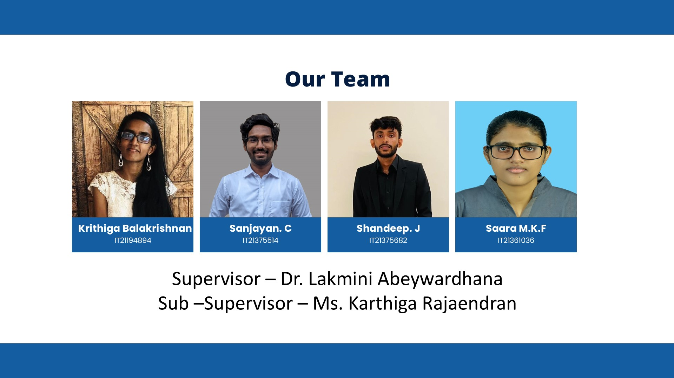
04/12/2024

Slide 3
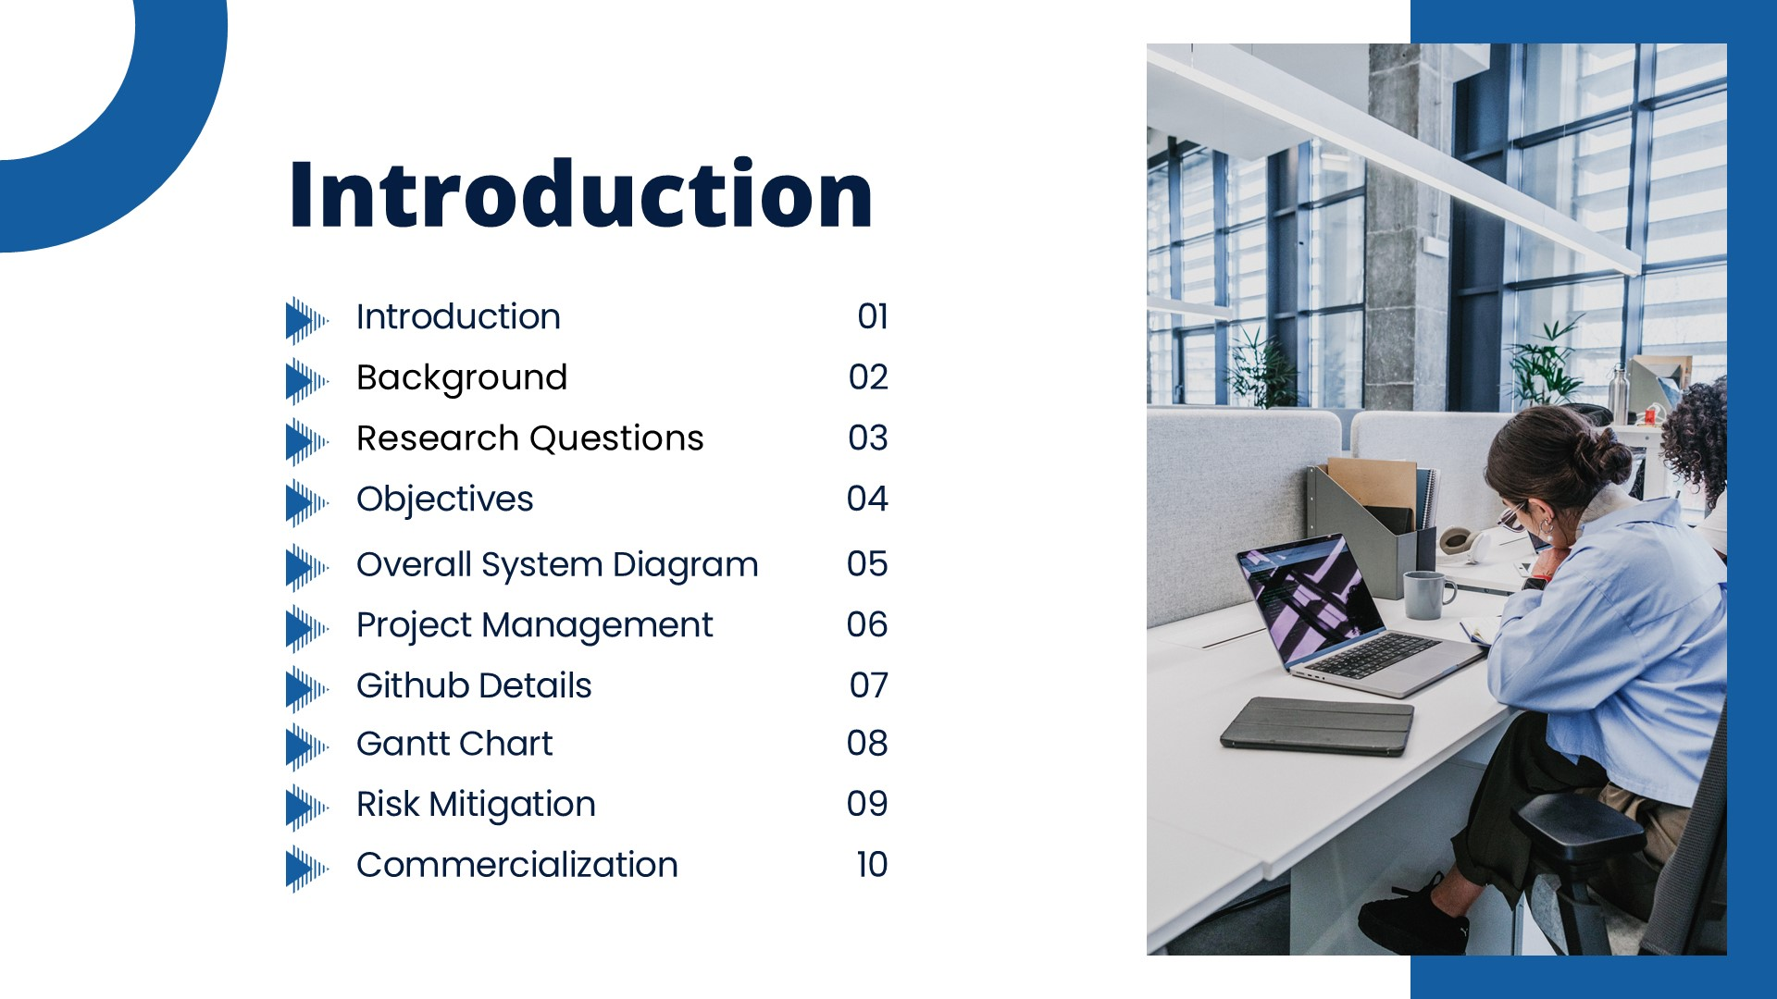
04/12/2024

Slide 4
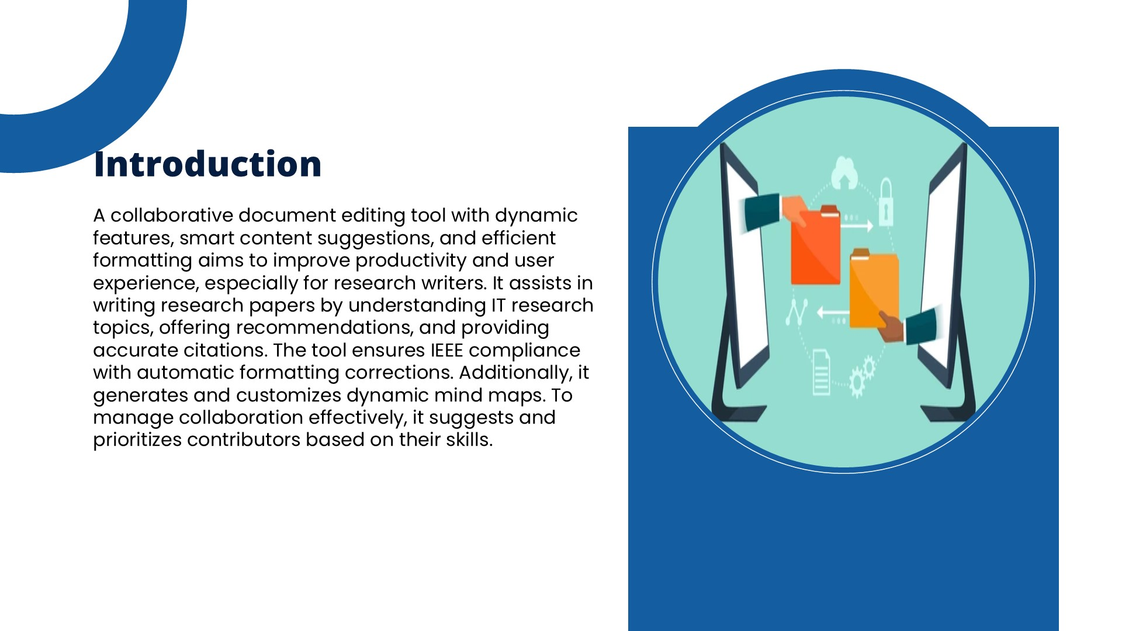
04/12/2024

Slide 5
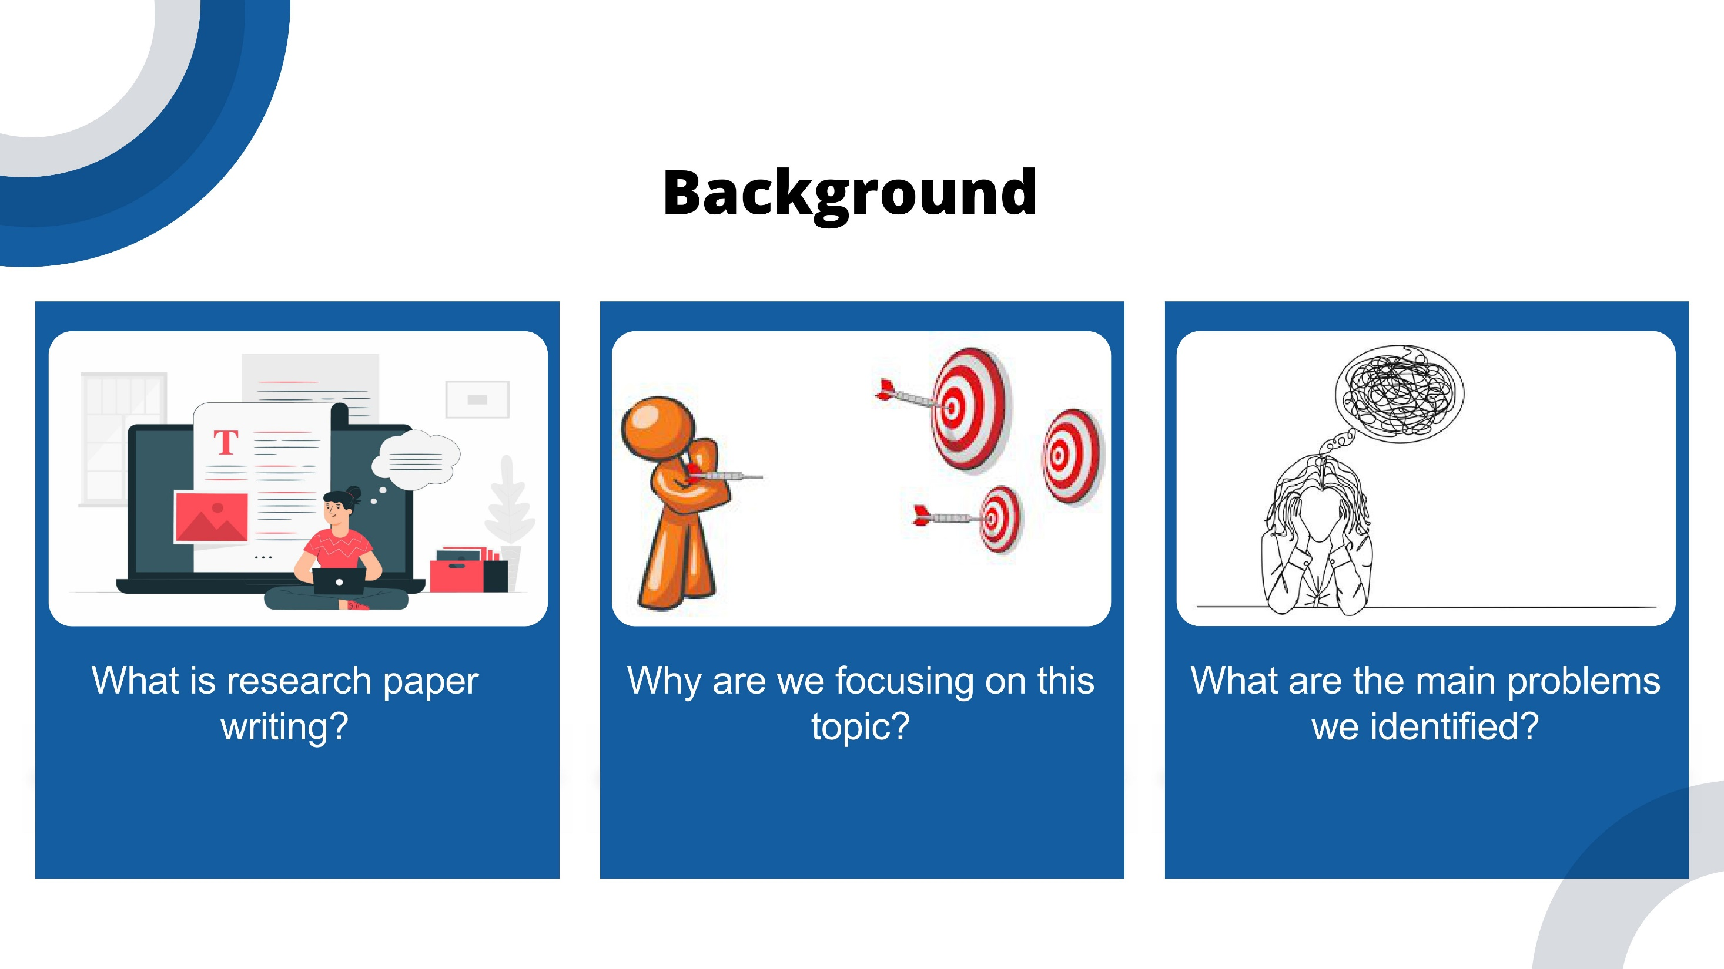
04/12/2024

Slide 6
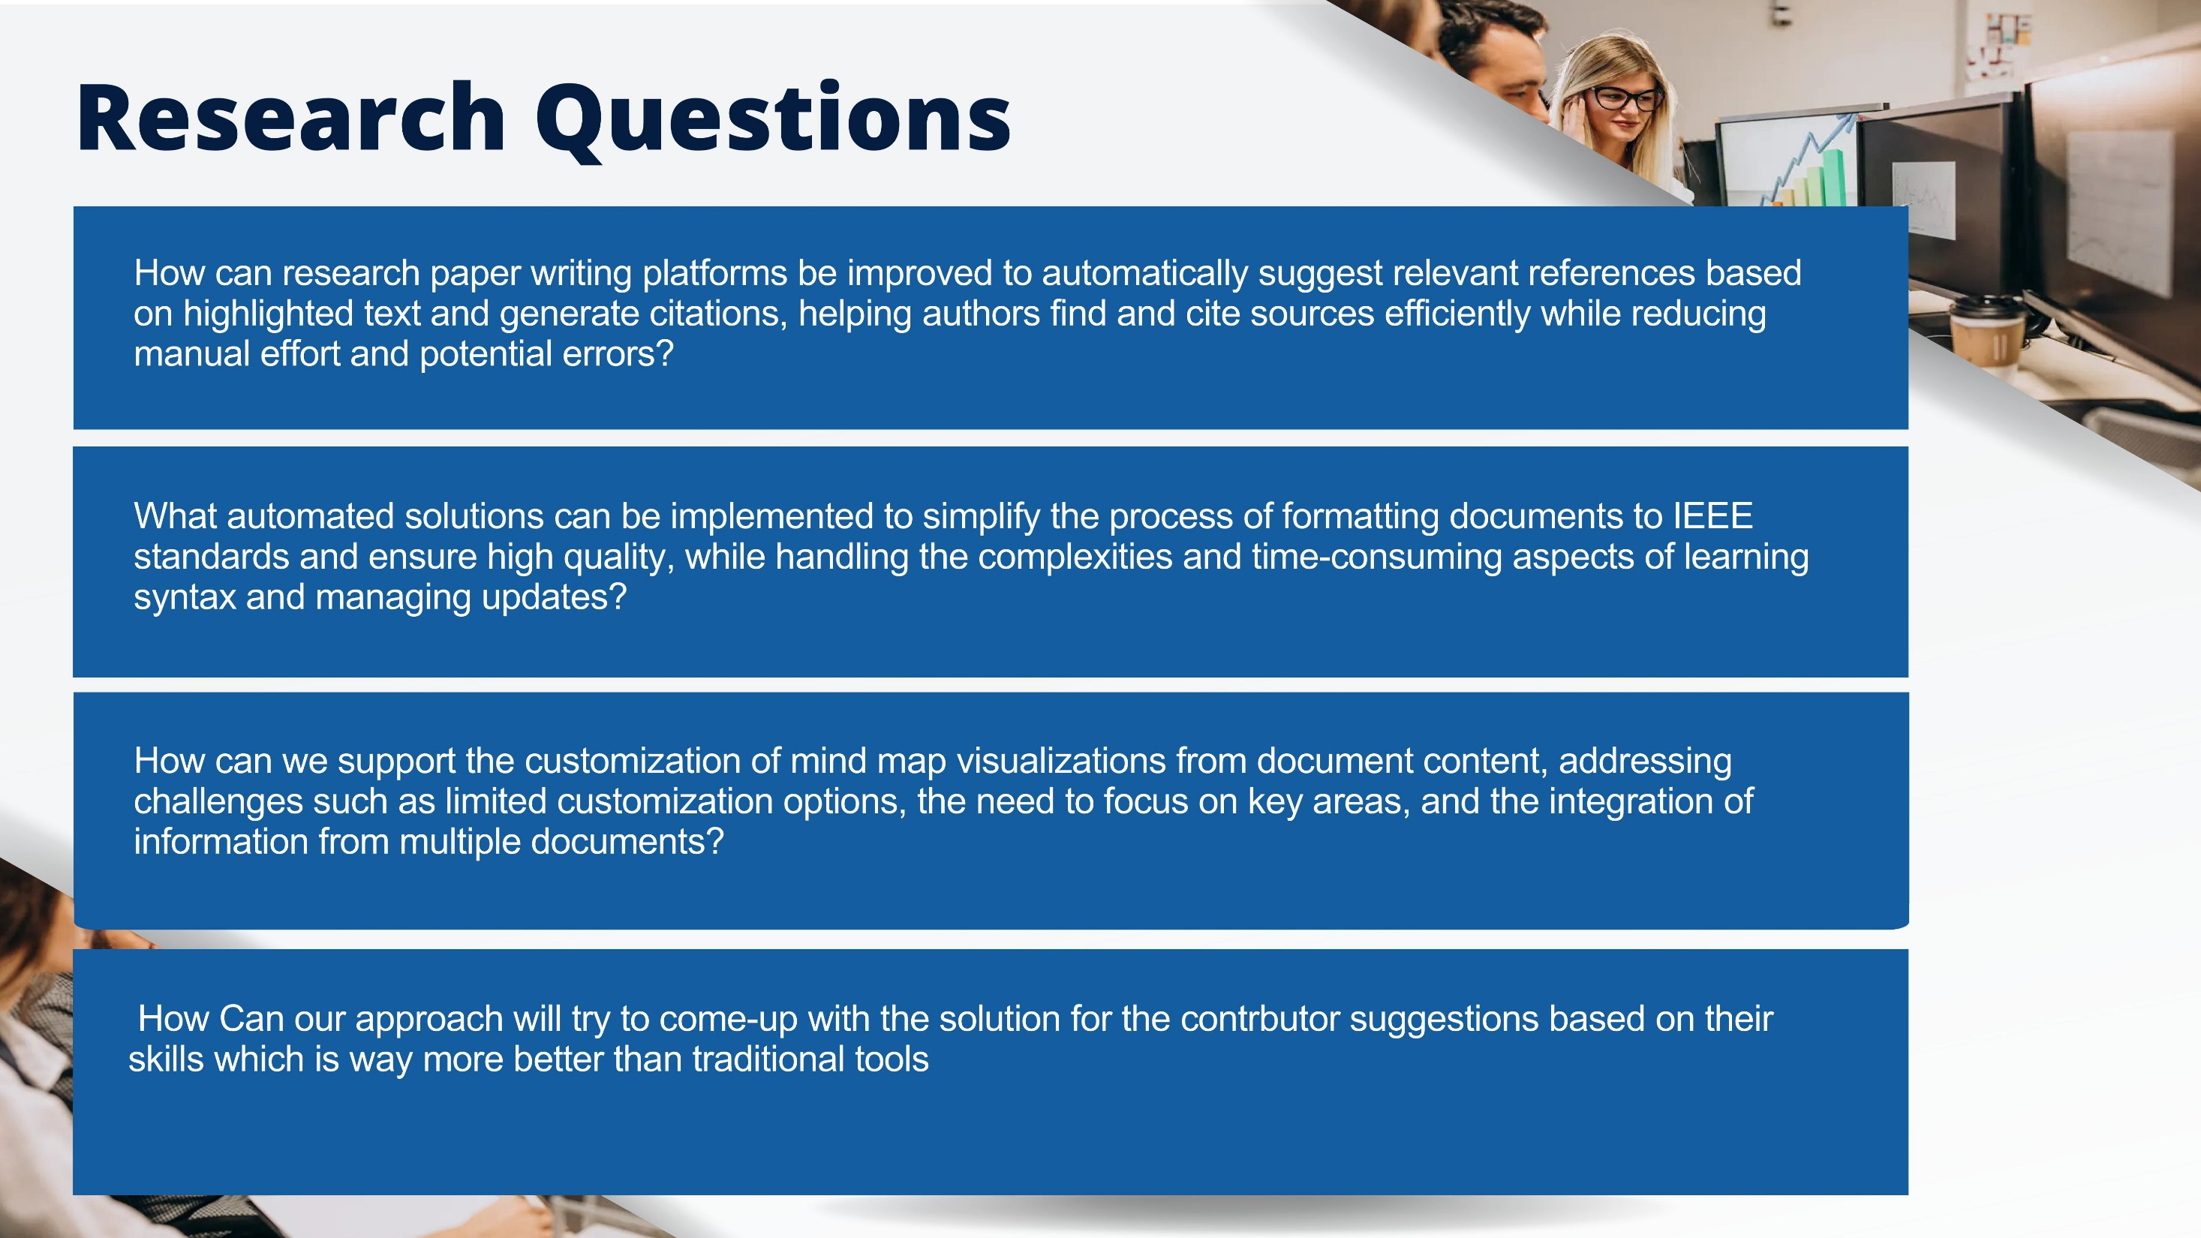
04/12/2024

Slide 7
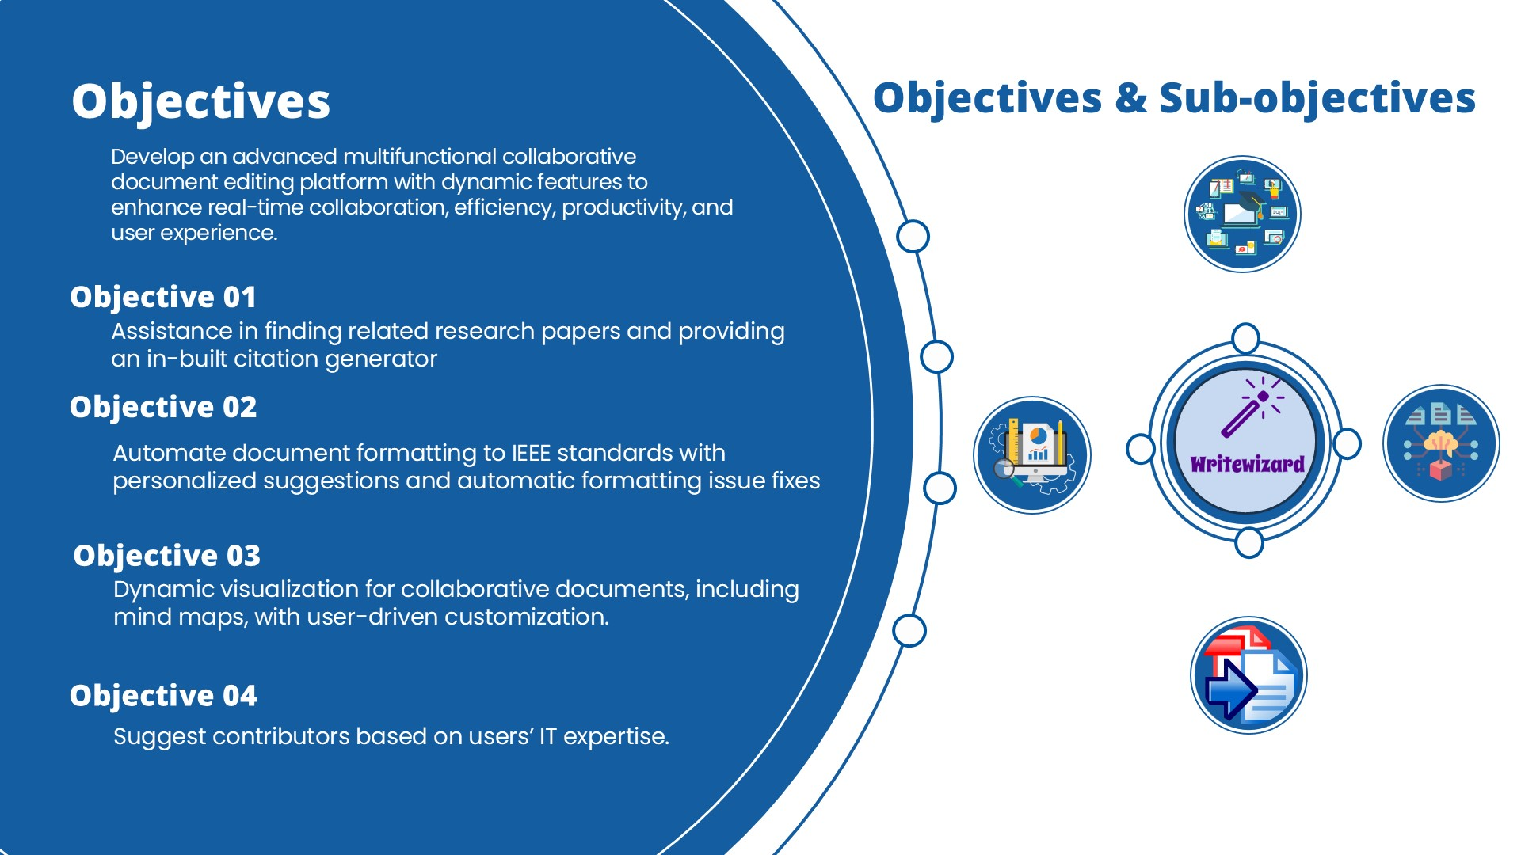
04/12/2024

Slide 8
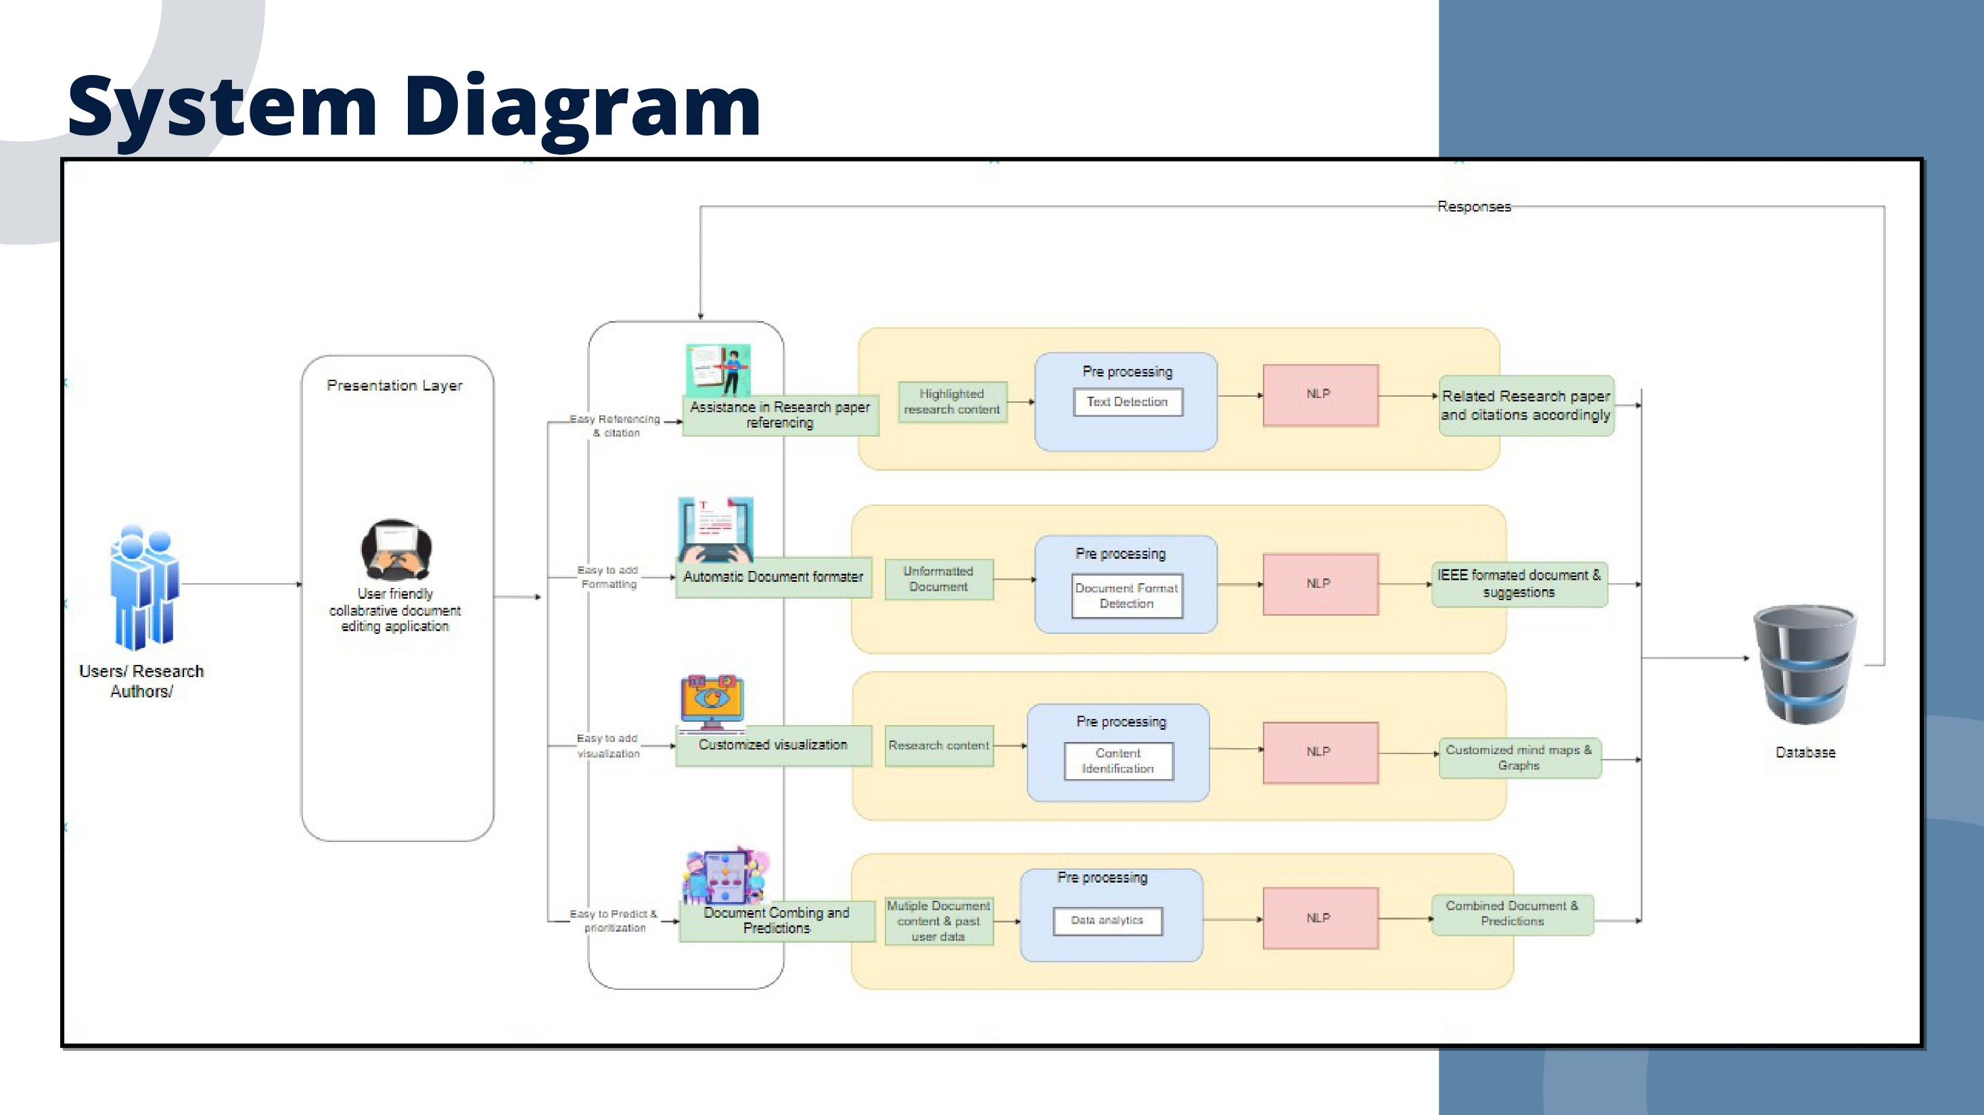
04/12/2024

Slide 9
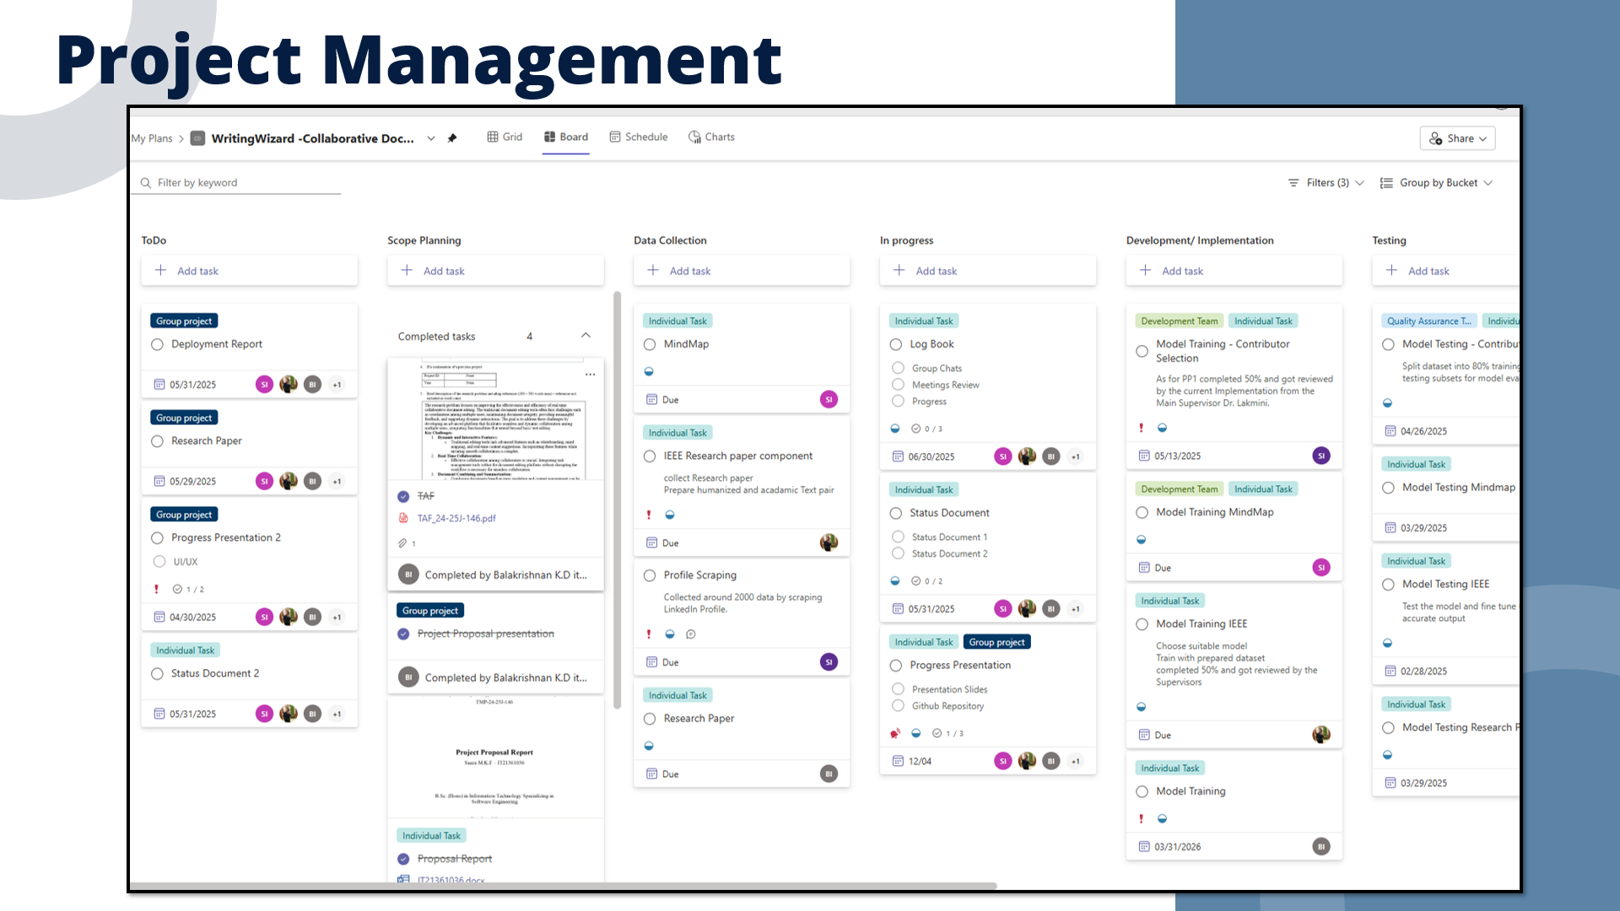
04/12/2024

Slide 10
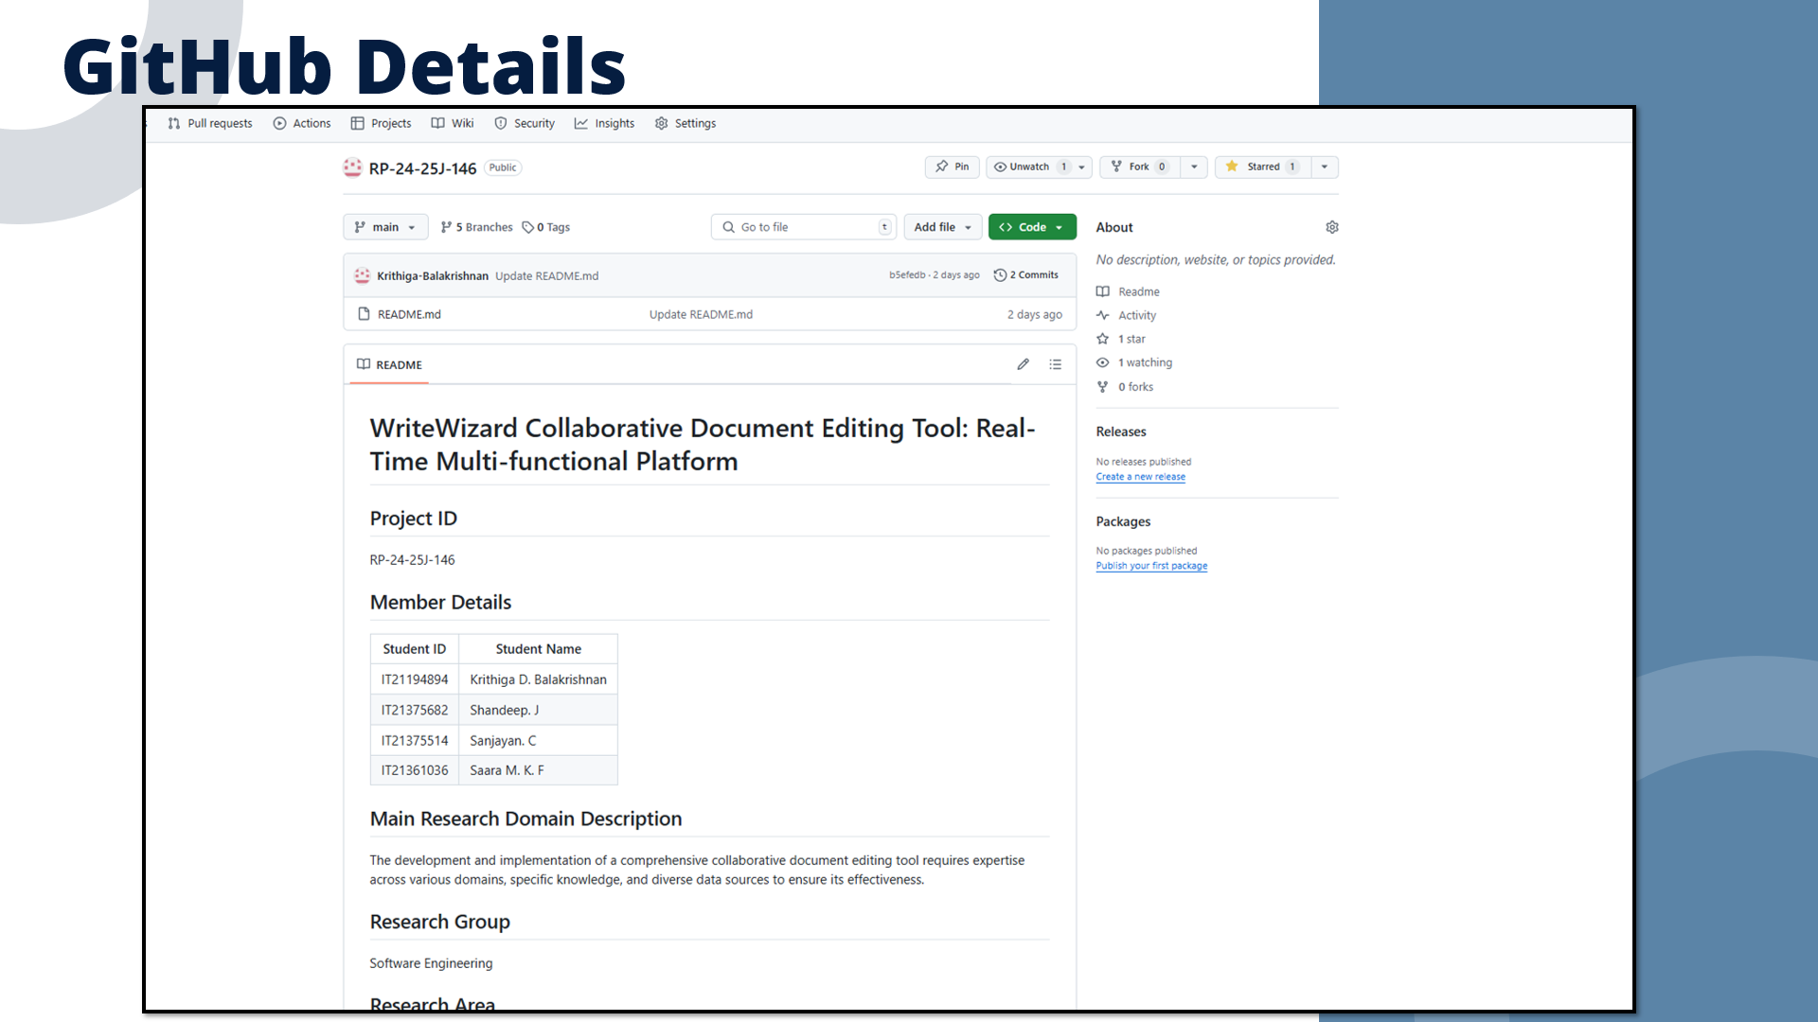
04/12/2024

Slide 11
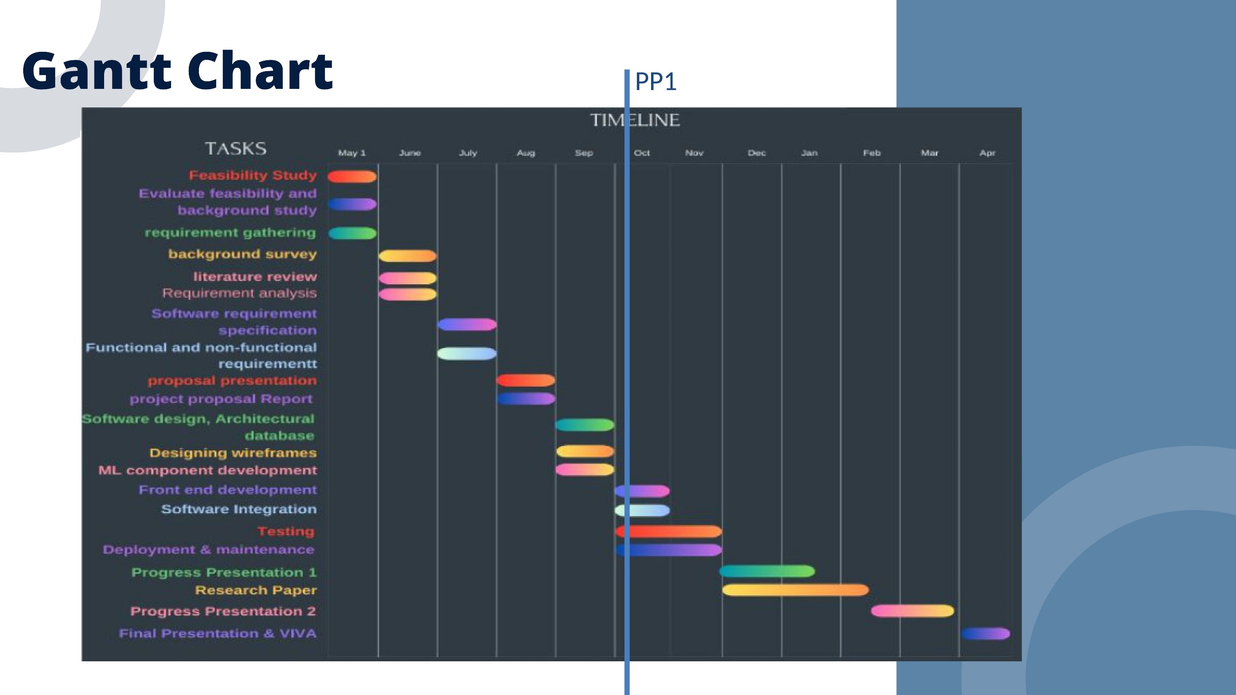
04/12/2024

Slide 12
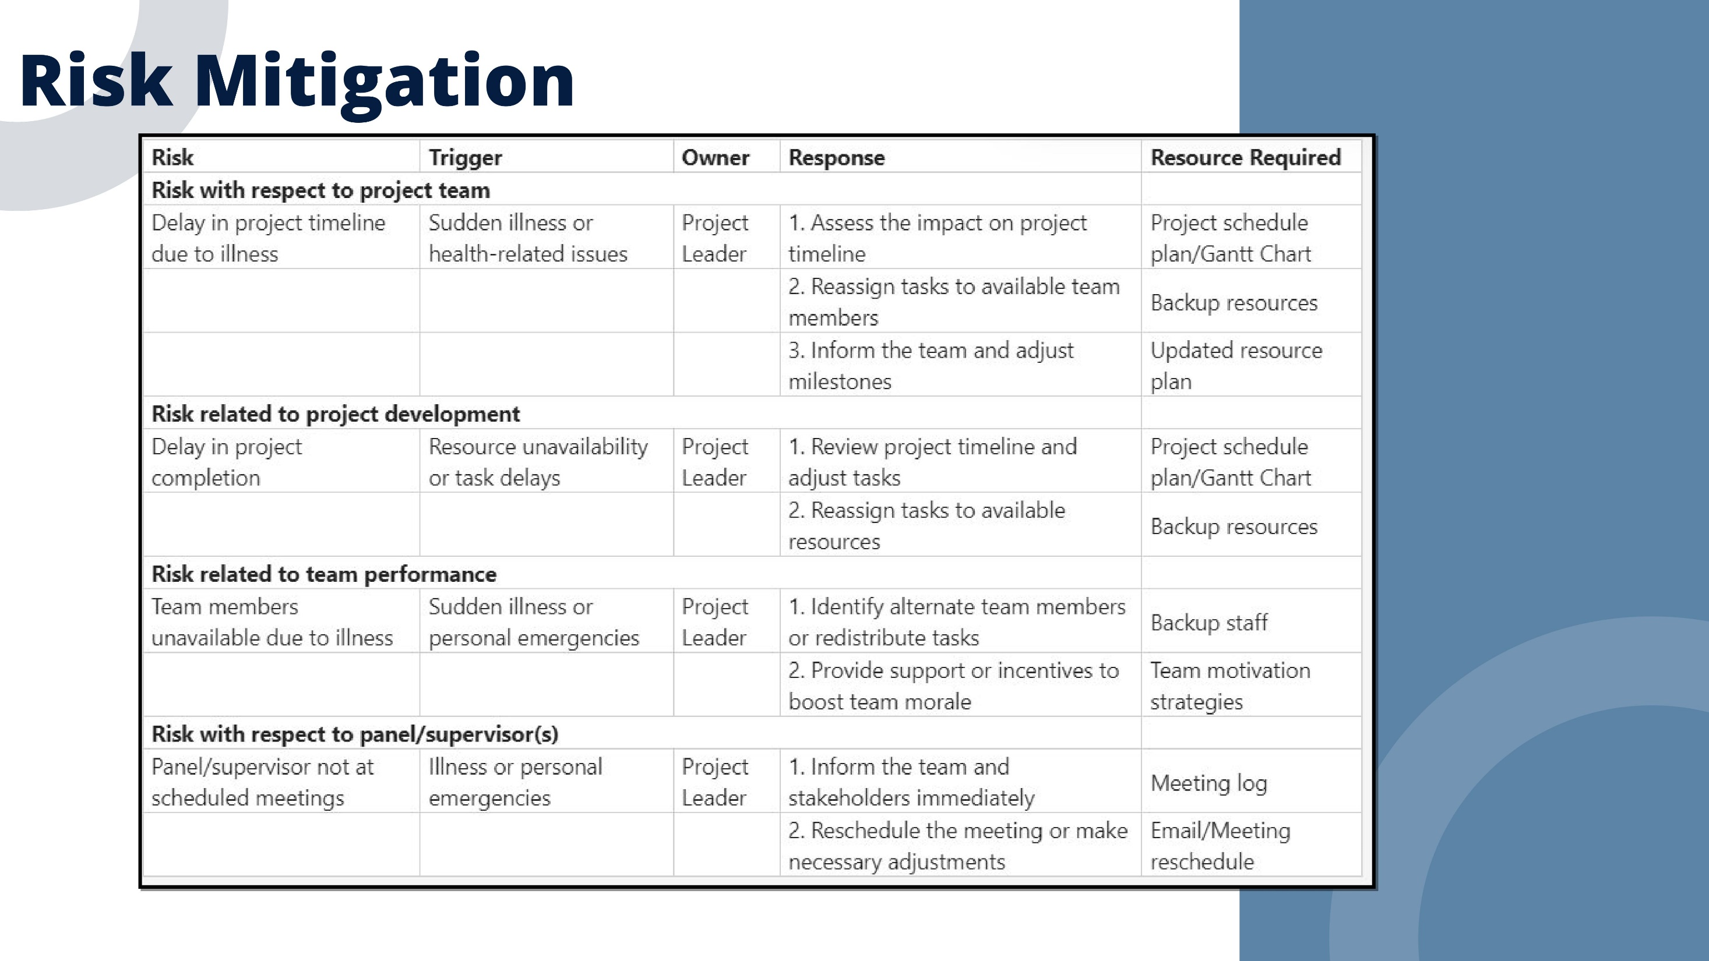
04/12/2024

Slide 13
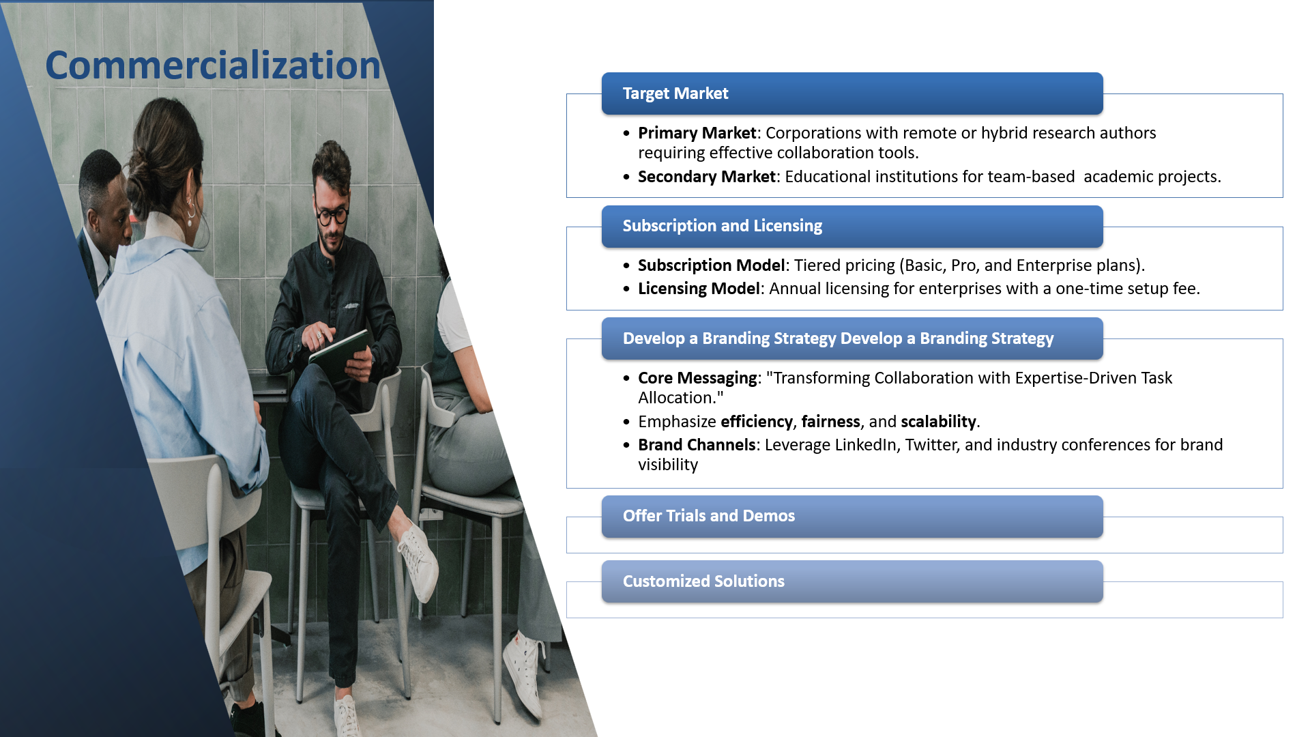
04/12/2024

Slide 14
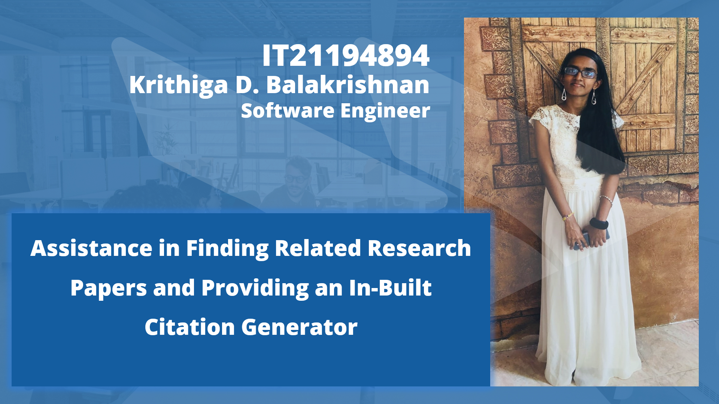
IT21194894 | Krithiga. D. Balakrishnan | 24-25J-146
04/12/2024

Slide 15
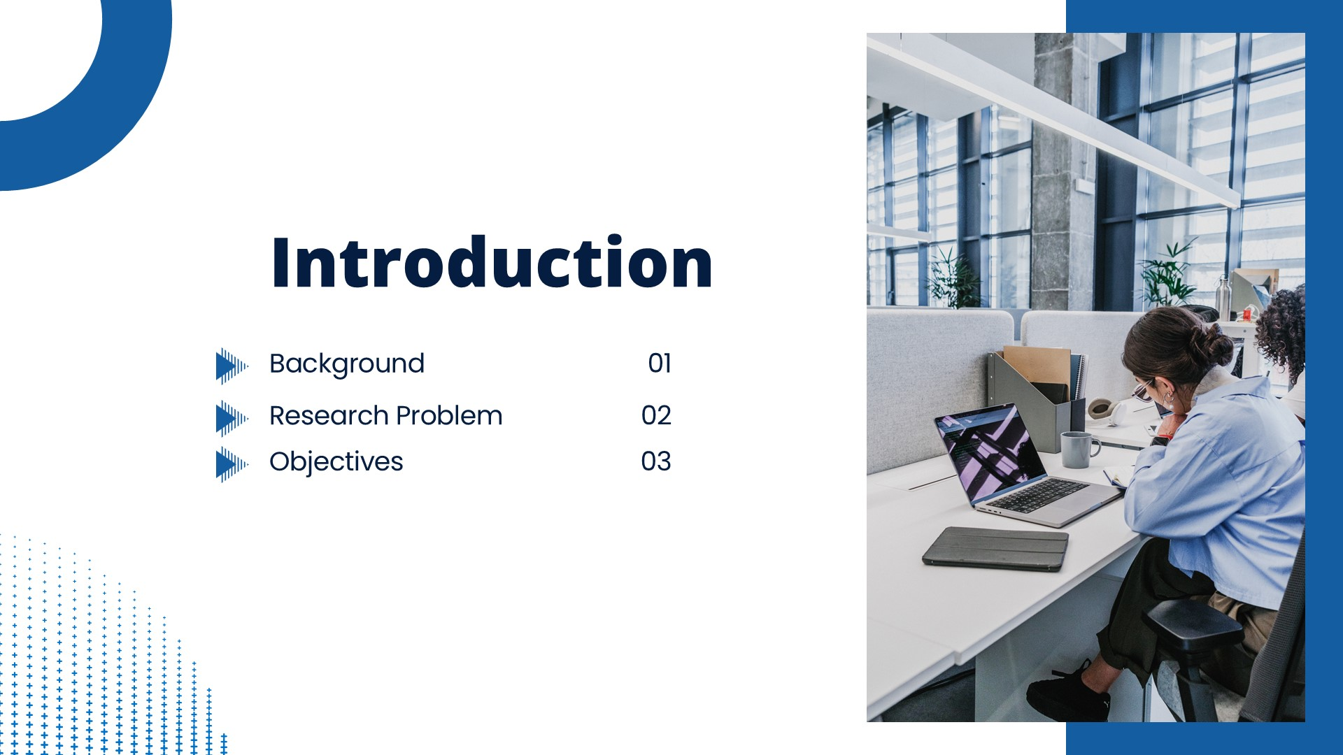
IT21194894 | Krithiga. D. Balakrishnan | 24-25J-146
04/12/2024

Slide 16
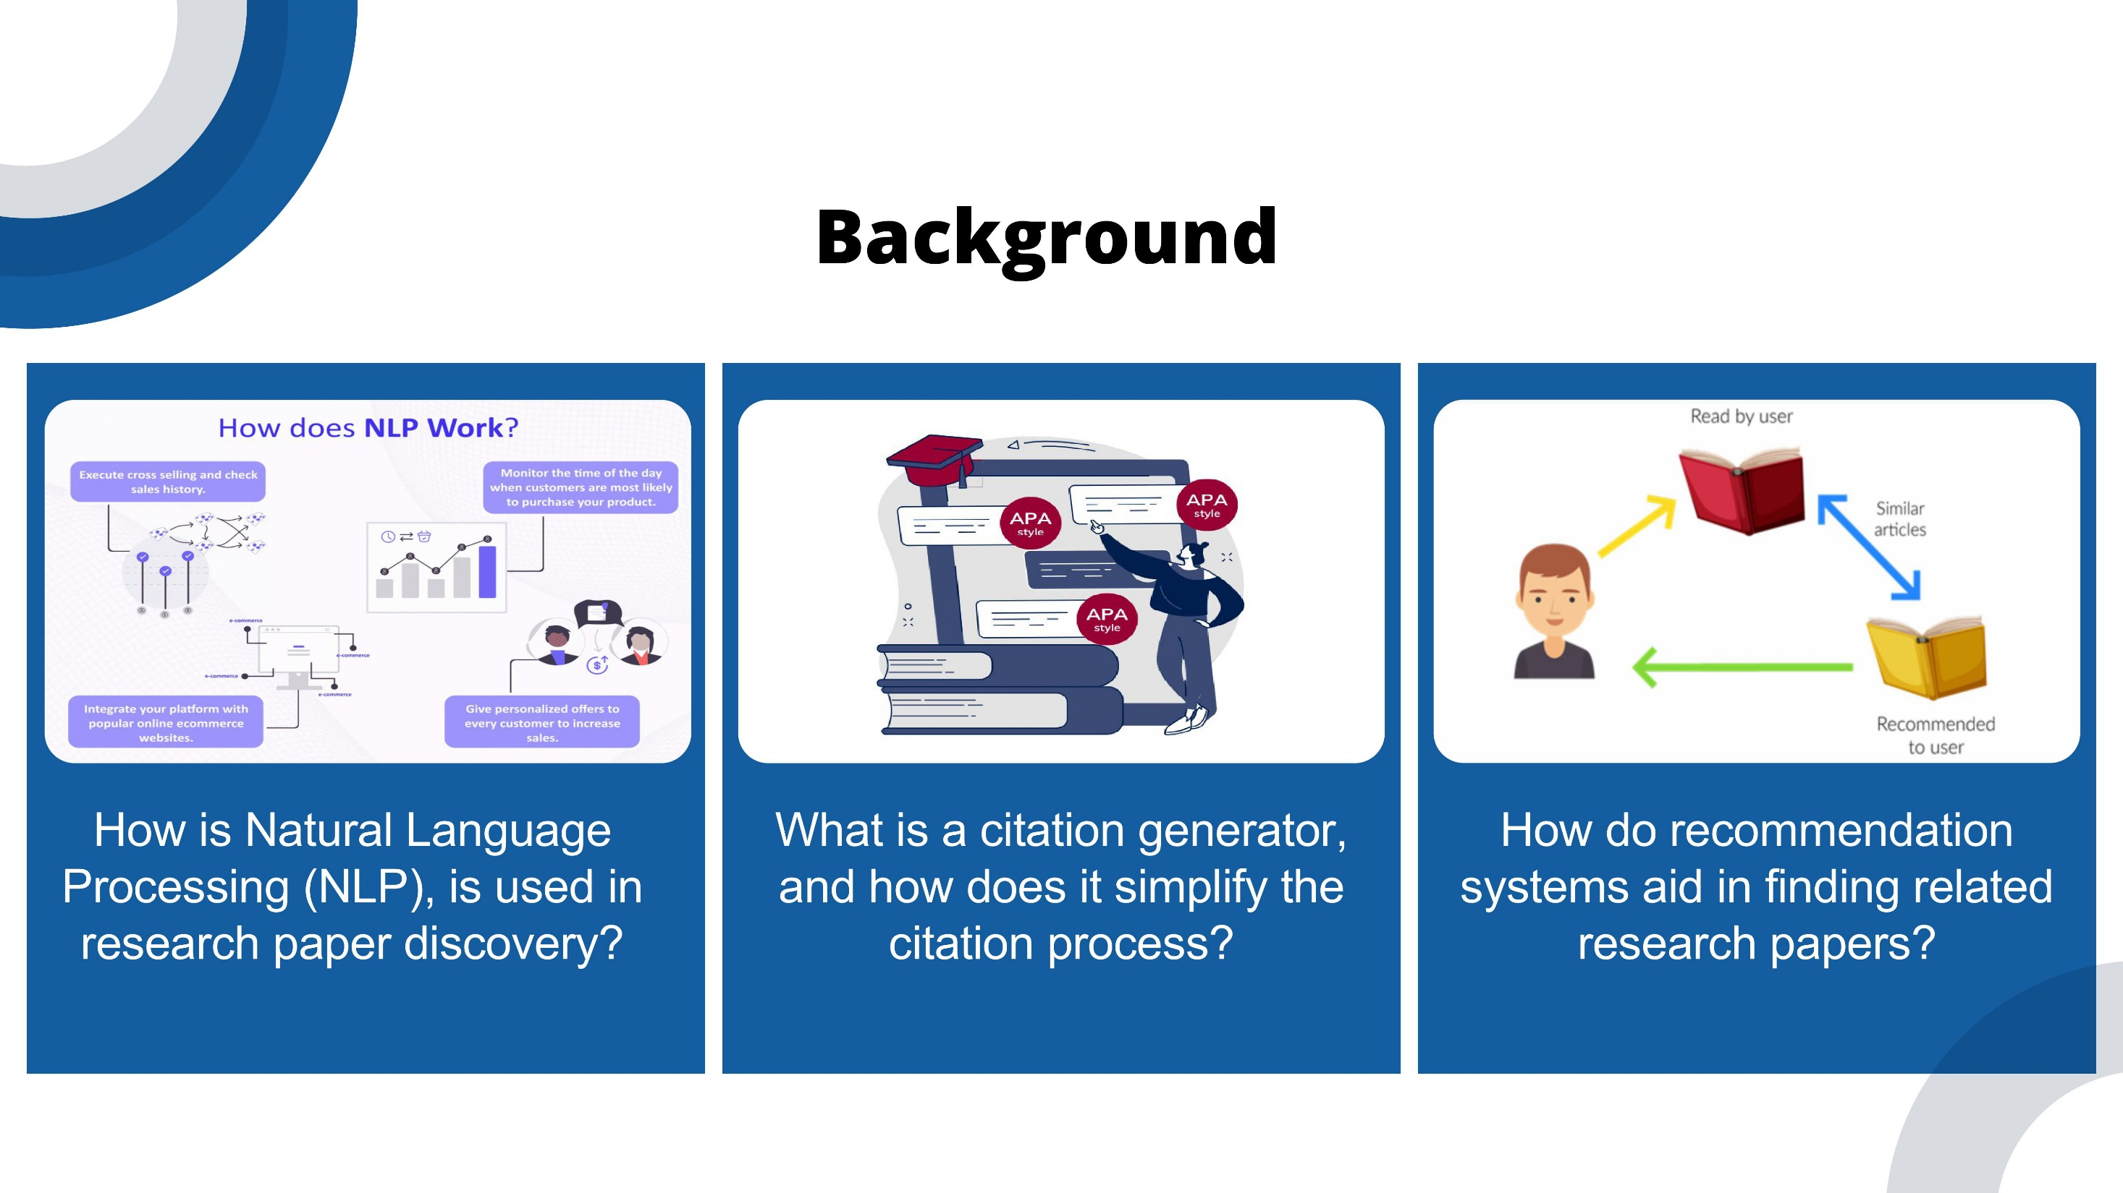
IT21194894 | Krithiga. D. Balakrishnan | 24-25J-146
04/12/2024

Slide 17
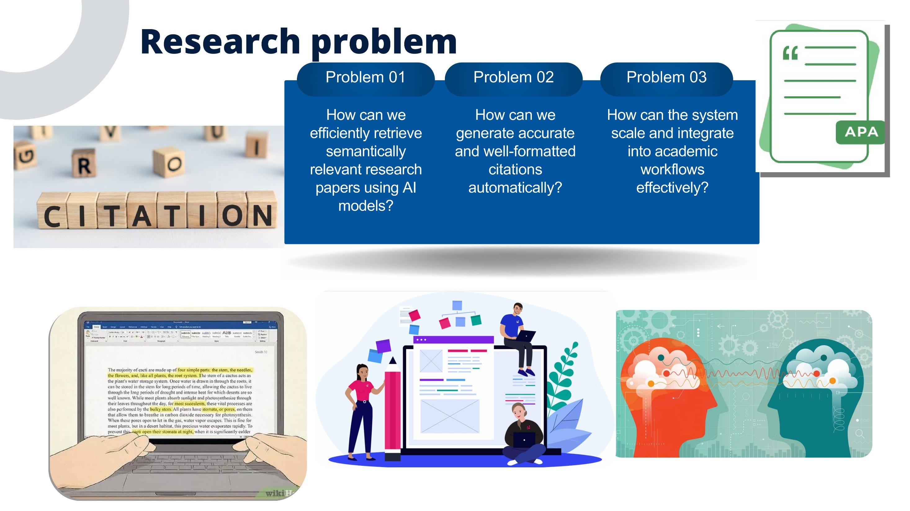
IT21194894 | Krithiga. D. Balakrishnan | 24-25J-146
04/12/2024

Slide 18
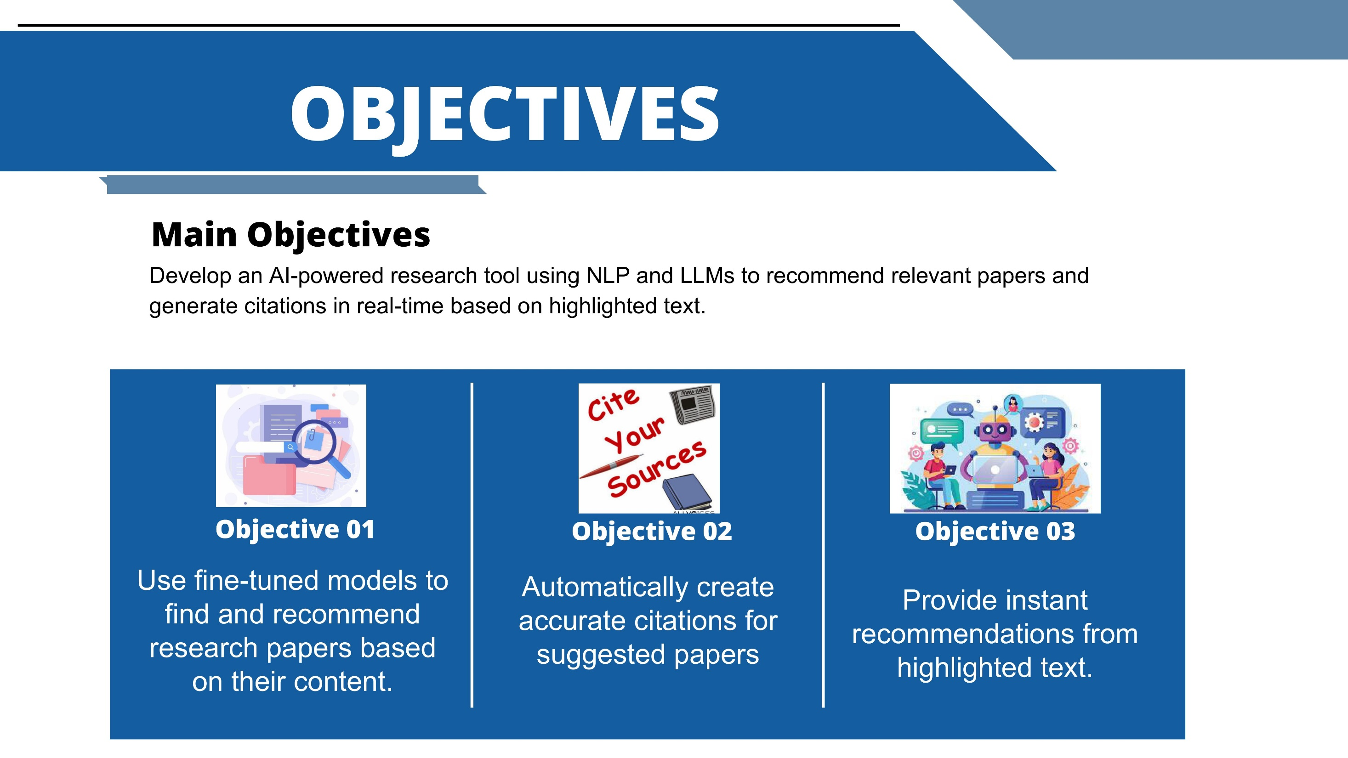
IT21194894 | Krithiga. D. Balakrishnan | 24-25J-146
04/12/2024

Slide 19
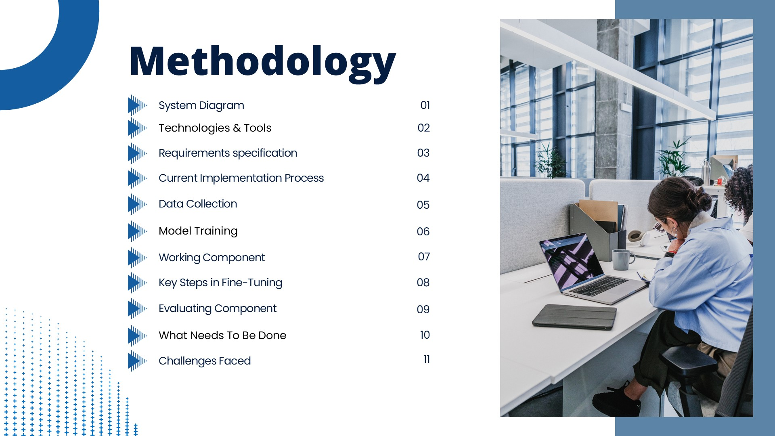
IT21194894 | Krithiga. D. Balakrishnan | 24-25J-146
04/12/2024

Slide 20
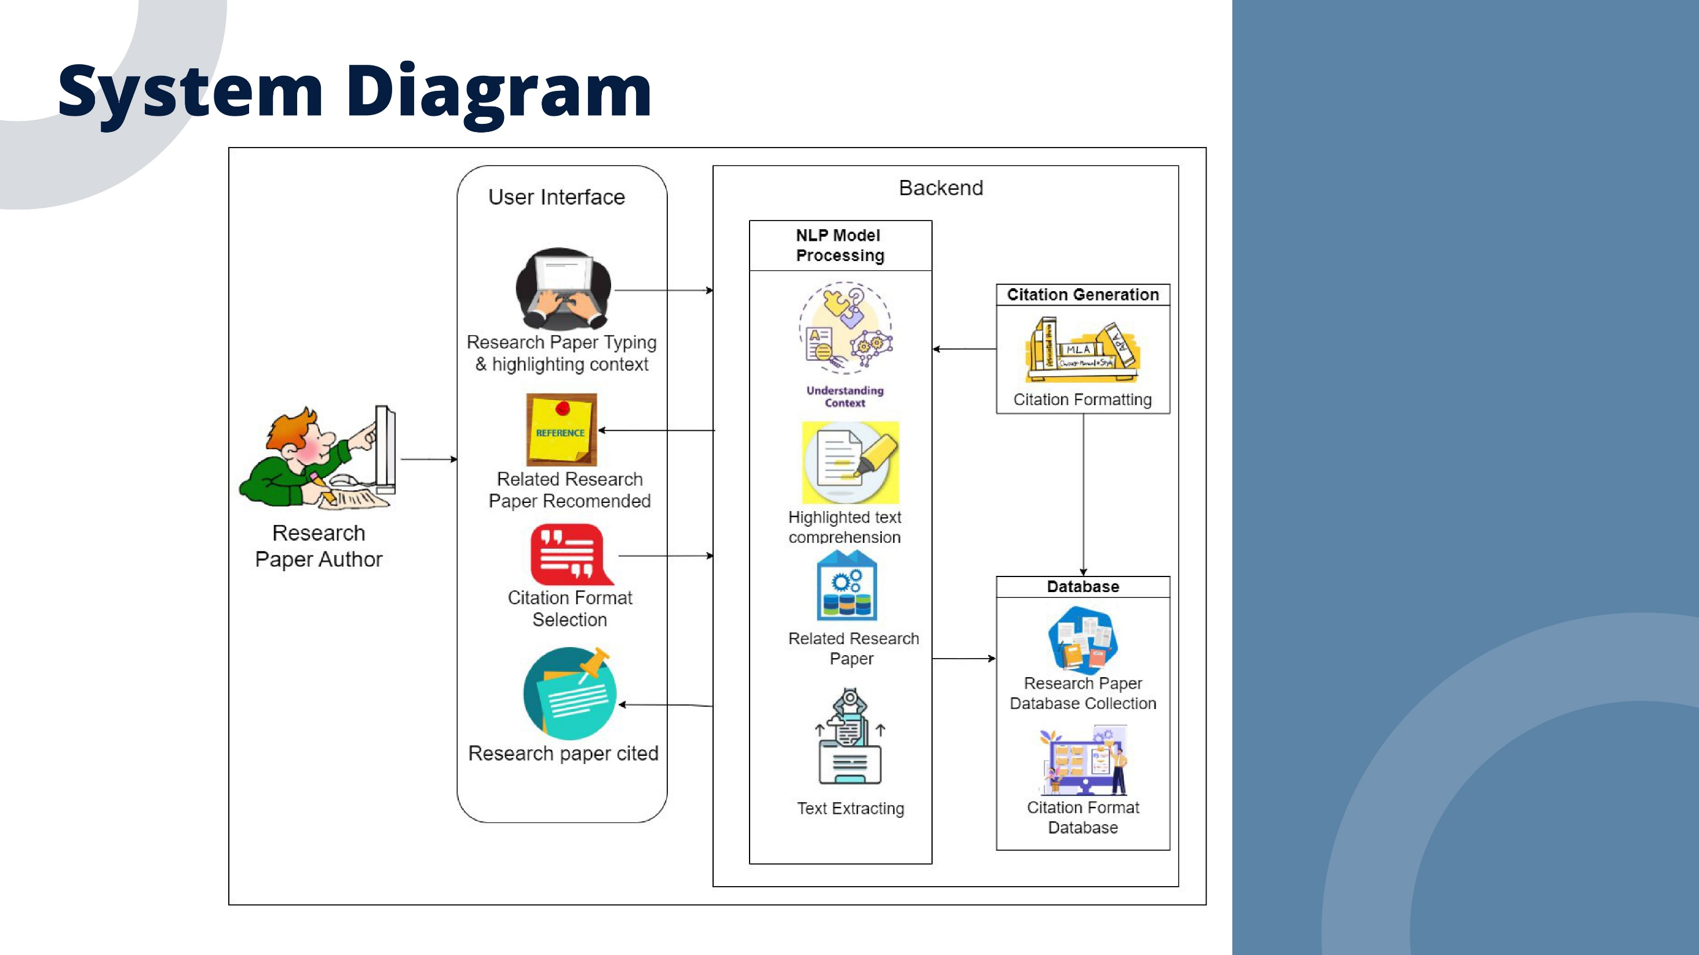
IT21194894 | Krithiga. D. Balakrishnan | 24-25J-146
04/12/2024

Slide 21
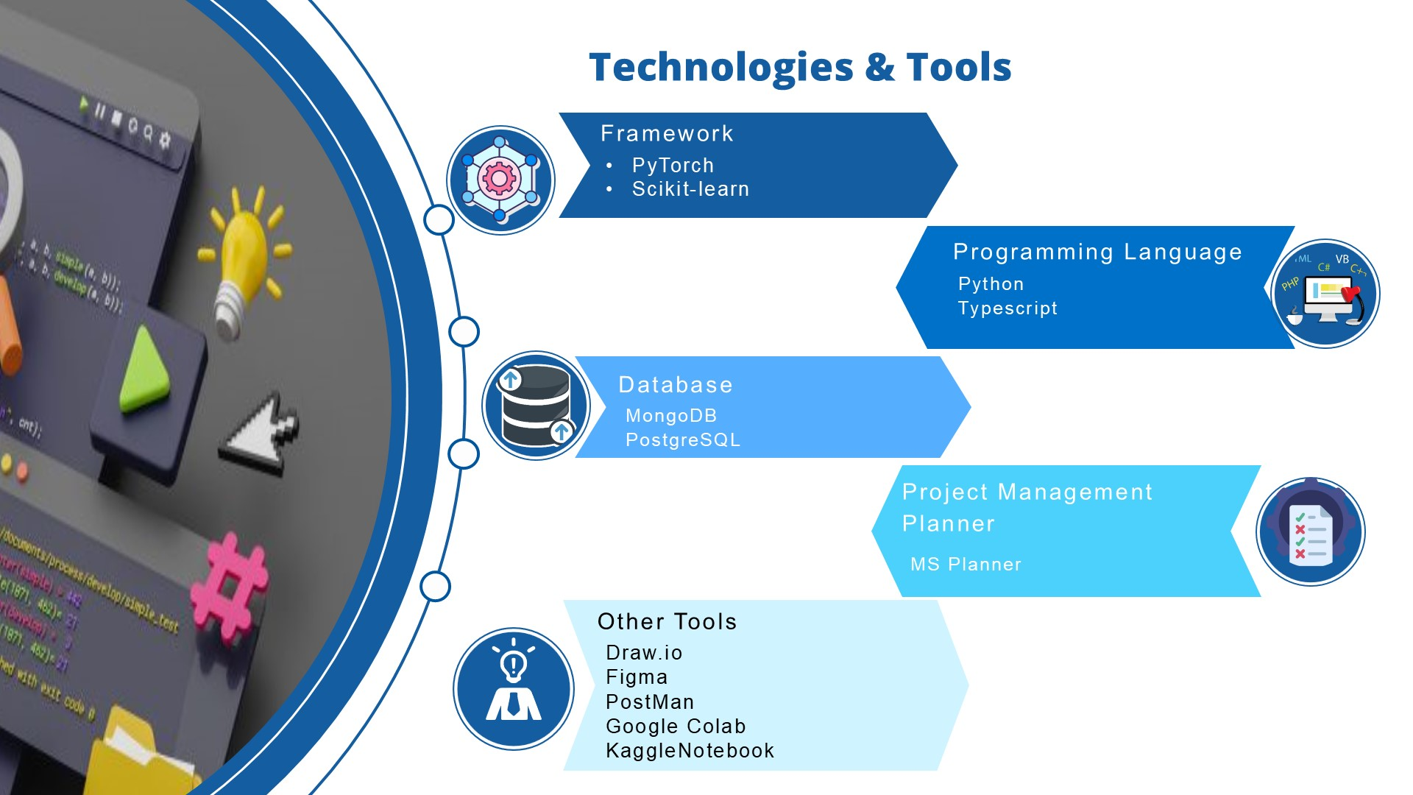
IT21194894 | Krithiga. D. Balakrishnan | 24-25J-146
04/12/2024

Slide 22
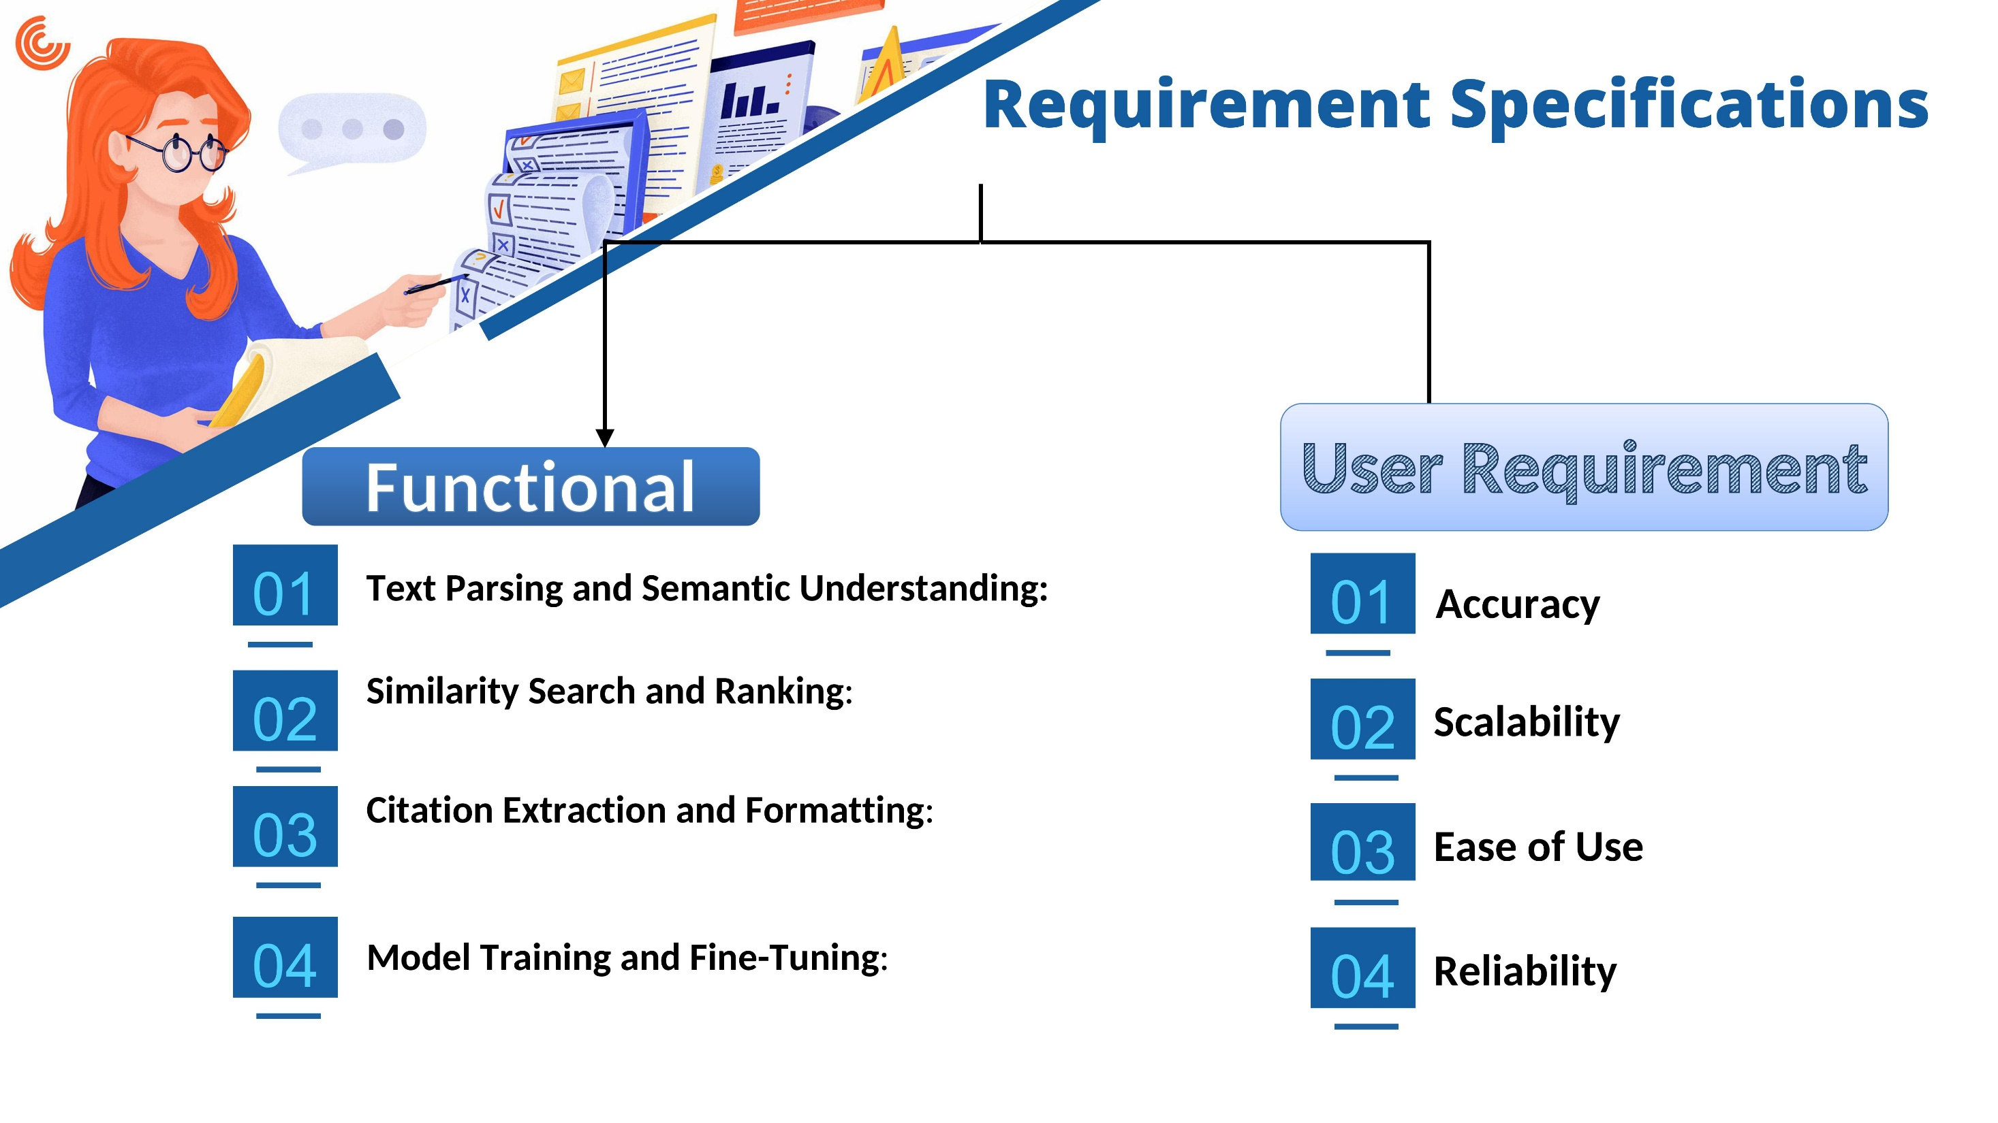
IT21194894 | Krithiga. D. Balakrishnan | 24-25J-146
04/12/2024

Slide 23
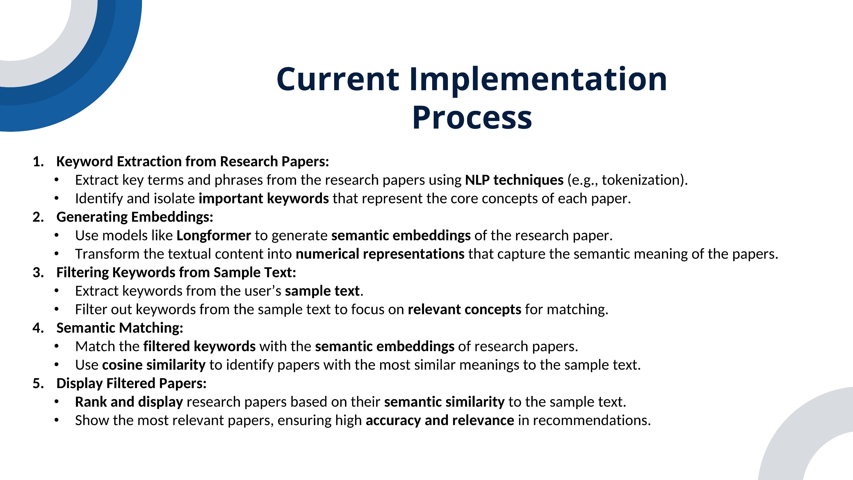
IT21194894 | Krithiga. D. Balakrishnan | 24-25J-146
04/12/2024

Slide 24
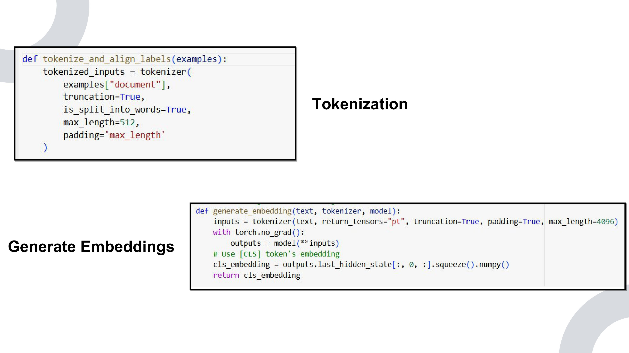
IT21194894 | Krithiga. D. Balakrishnan | 24-25J-146
04/12/2024

Slide 25
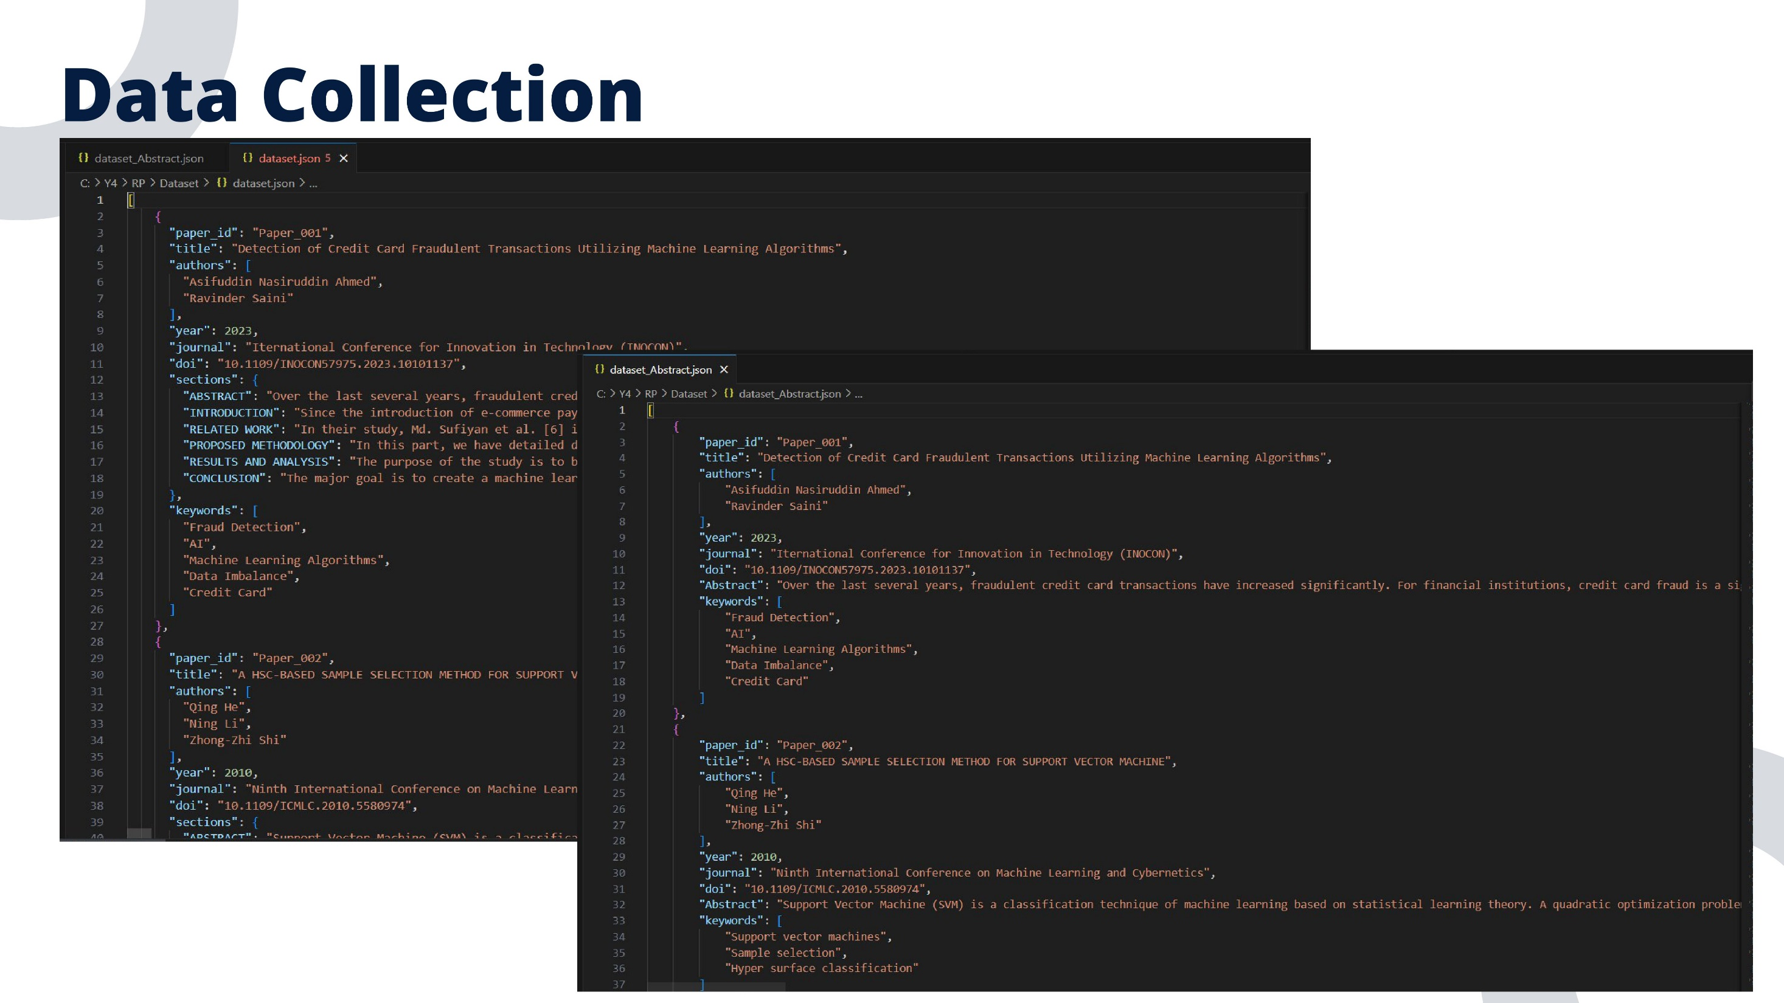
IT21194894 | Krithiga. D. Balakrishnan | 24-25J-146
04/12/2024

Slide 26
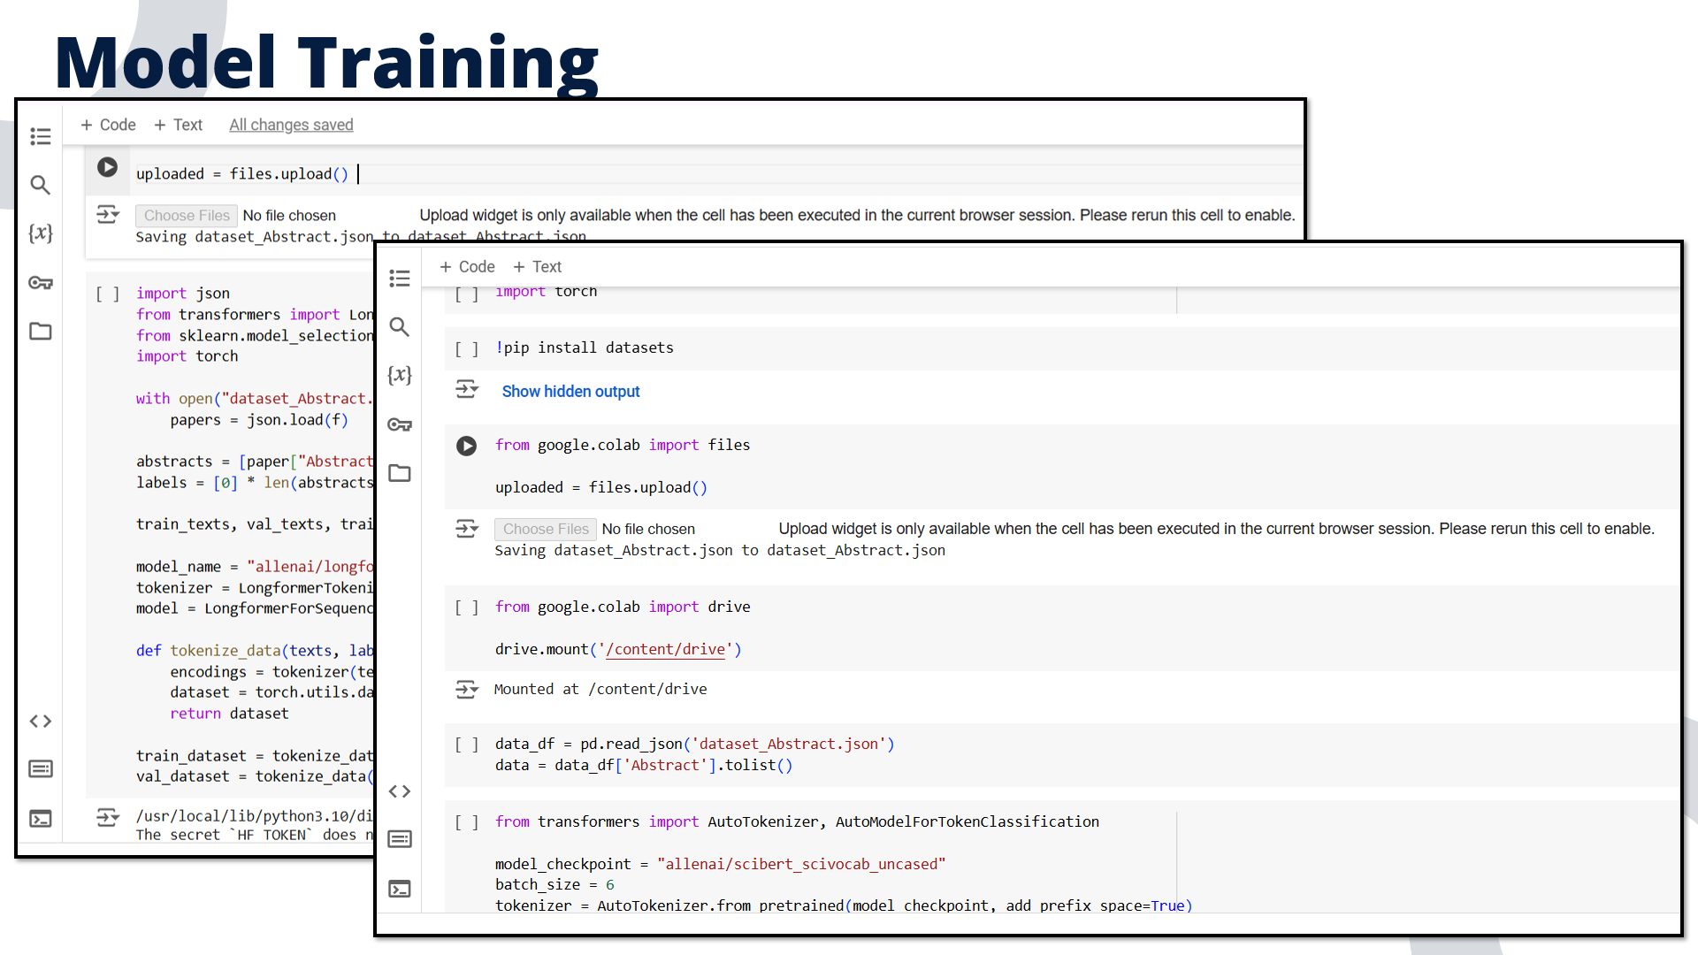
IT21194894 | Krithiga. D. Balakrishnan | 24-25J-146
04/12/2024

Slide 27
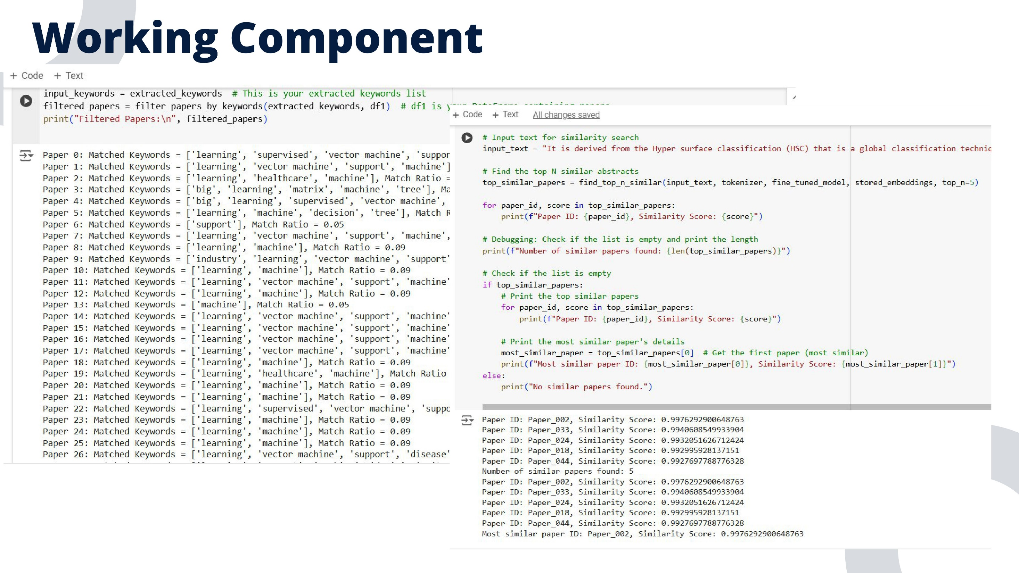
IT21194894 | Krithiga. D. Balakrishnan | 24-25J-146
04/12/2024

Slide 28
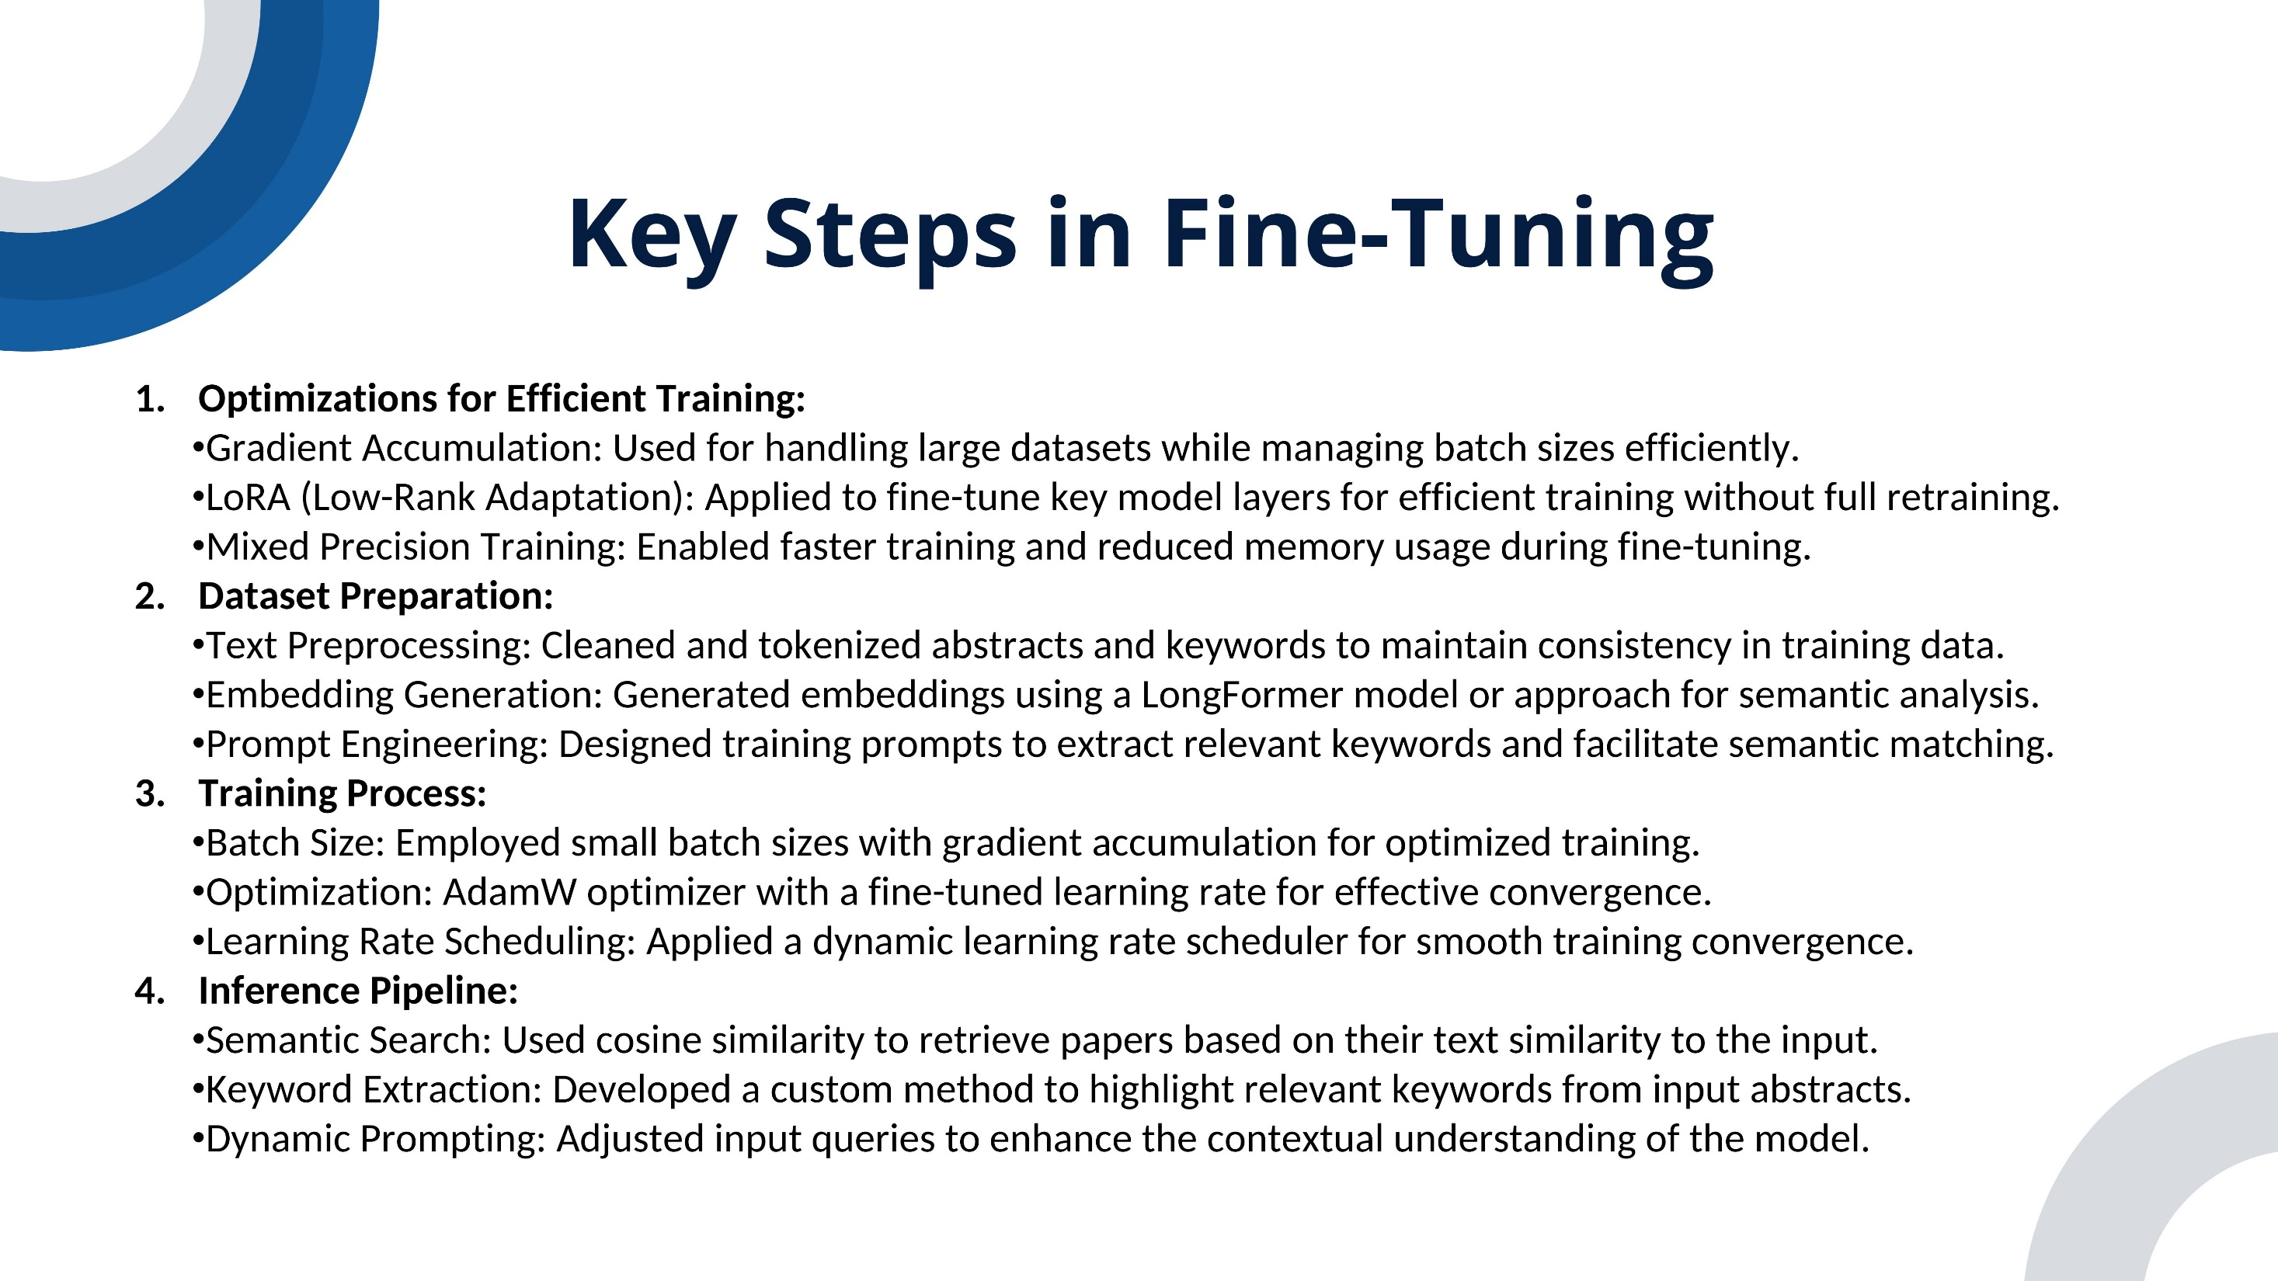
IT21194894 | Krithiga. D. Balakrishnan | 24-25J-146
04/12/2024

Slide 29
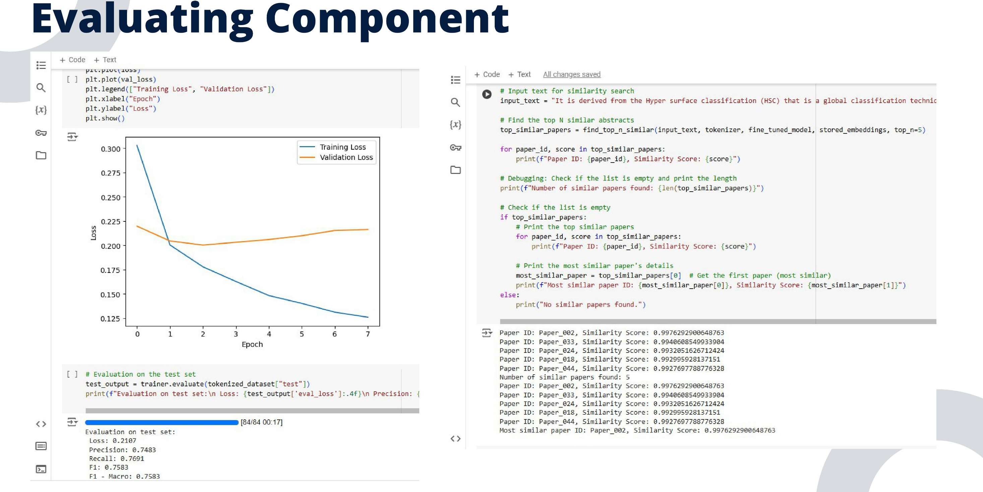
IT21194894 | Krithiga. D. Balakrishnan | 24-25J-146
04/12/2024

Slide 30
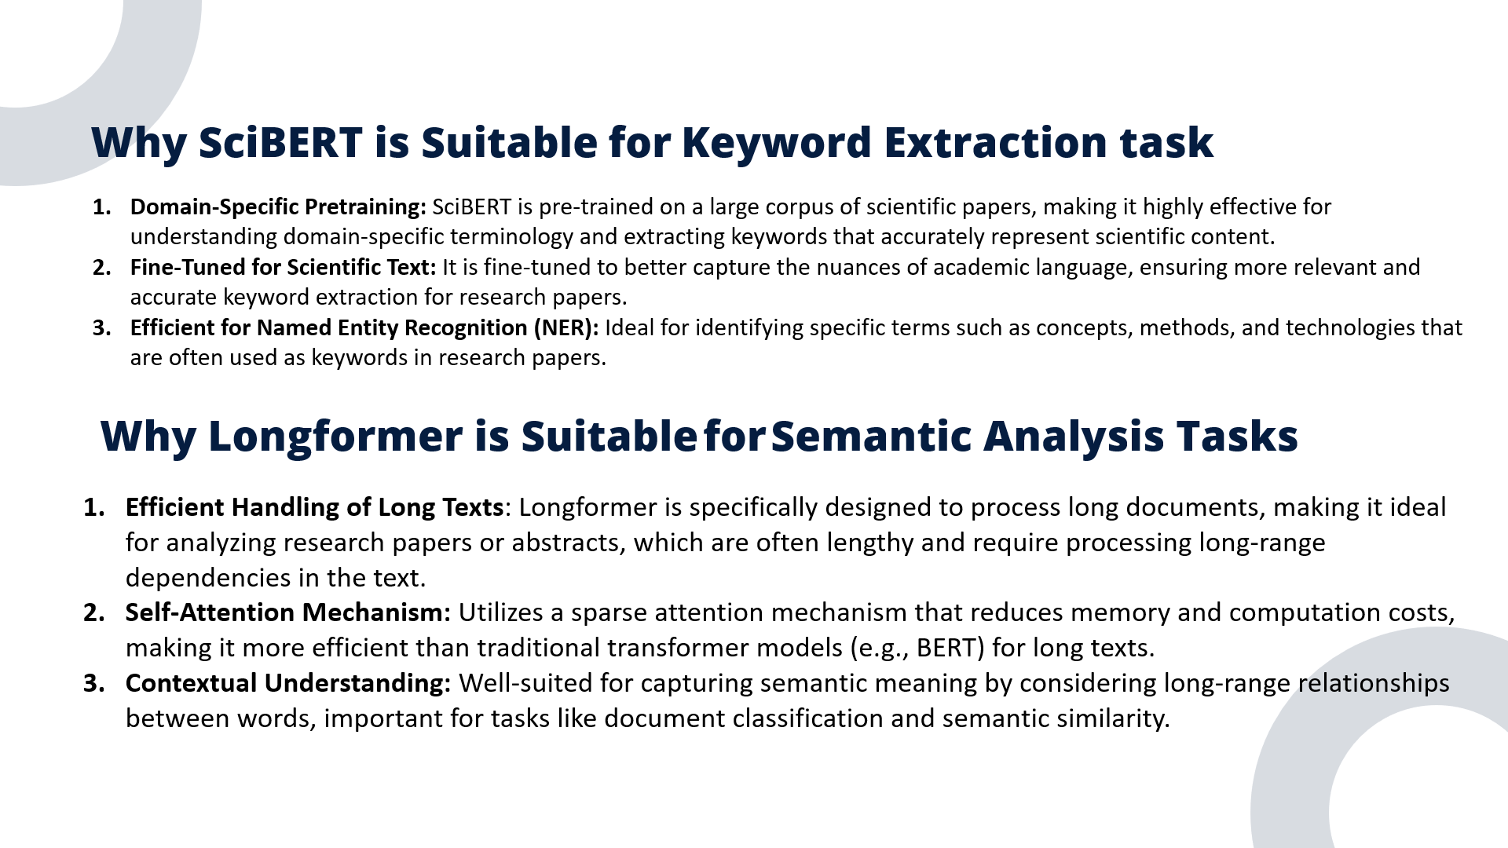
IT21194894 | Krithiga. D. Balakrishnan | 24-25J-146
04/12/2024

Slide 31
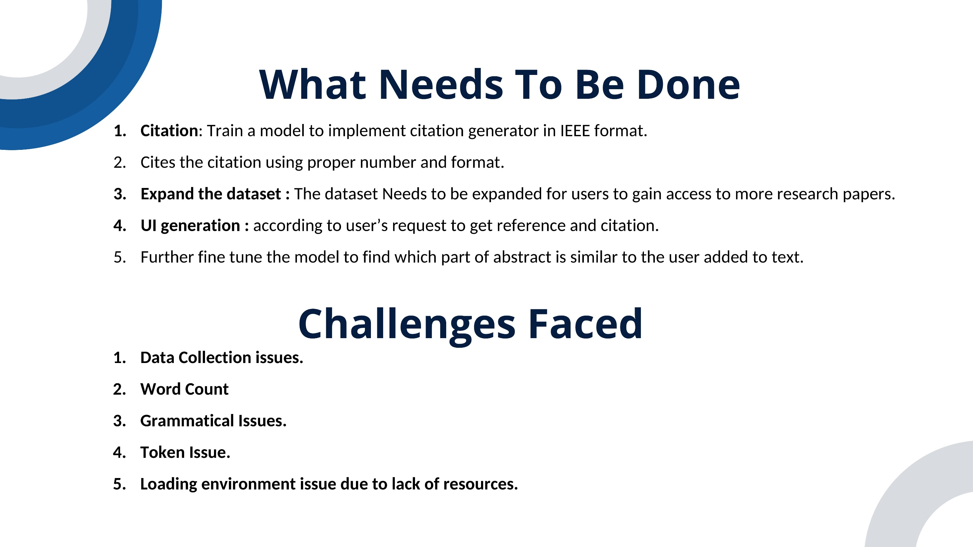
IT21194894 | Krithiga. D. Balakrishnan | 24-25J-146
04/12/2024

Slide 32
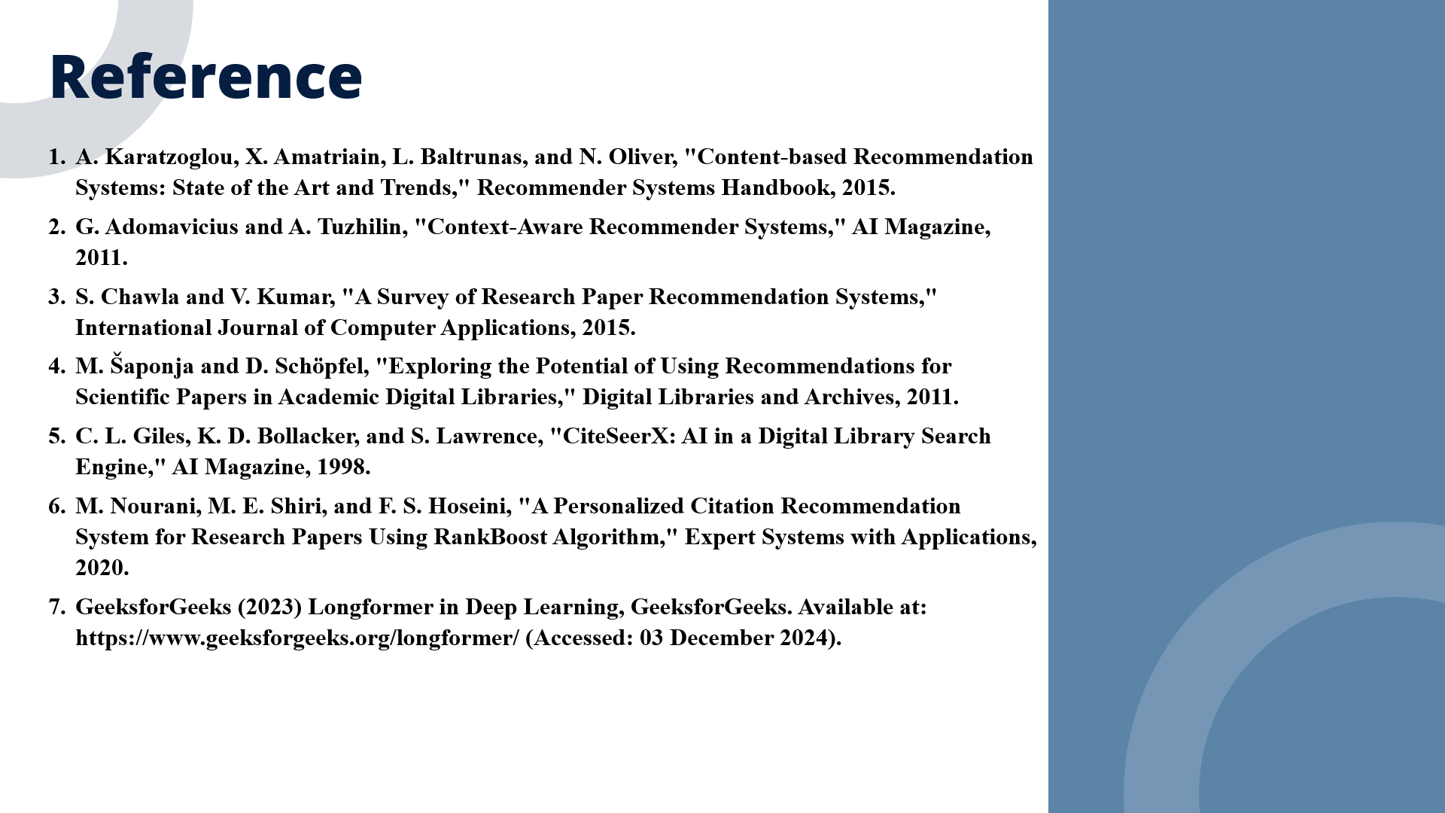
IT21194894 | Krithiga. D. Balakrishnan | 24-25J-146
04/12/2024

Slide 33
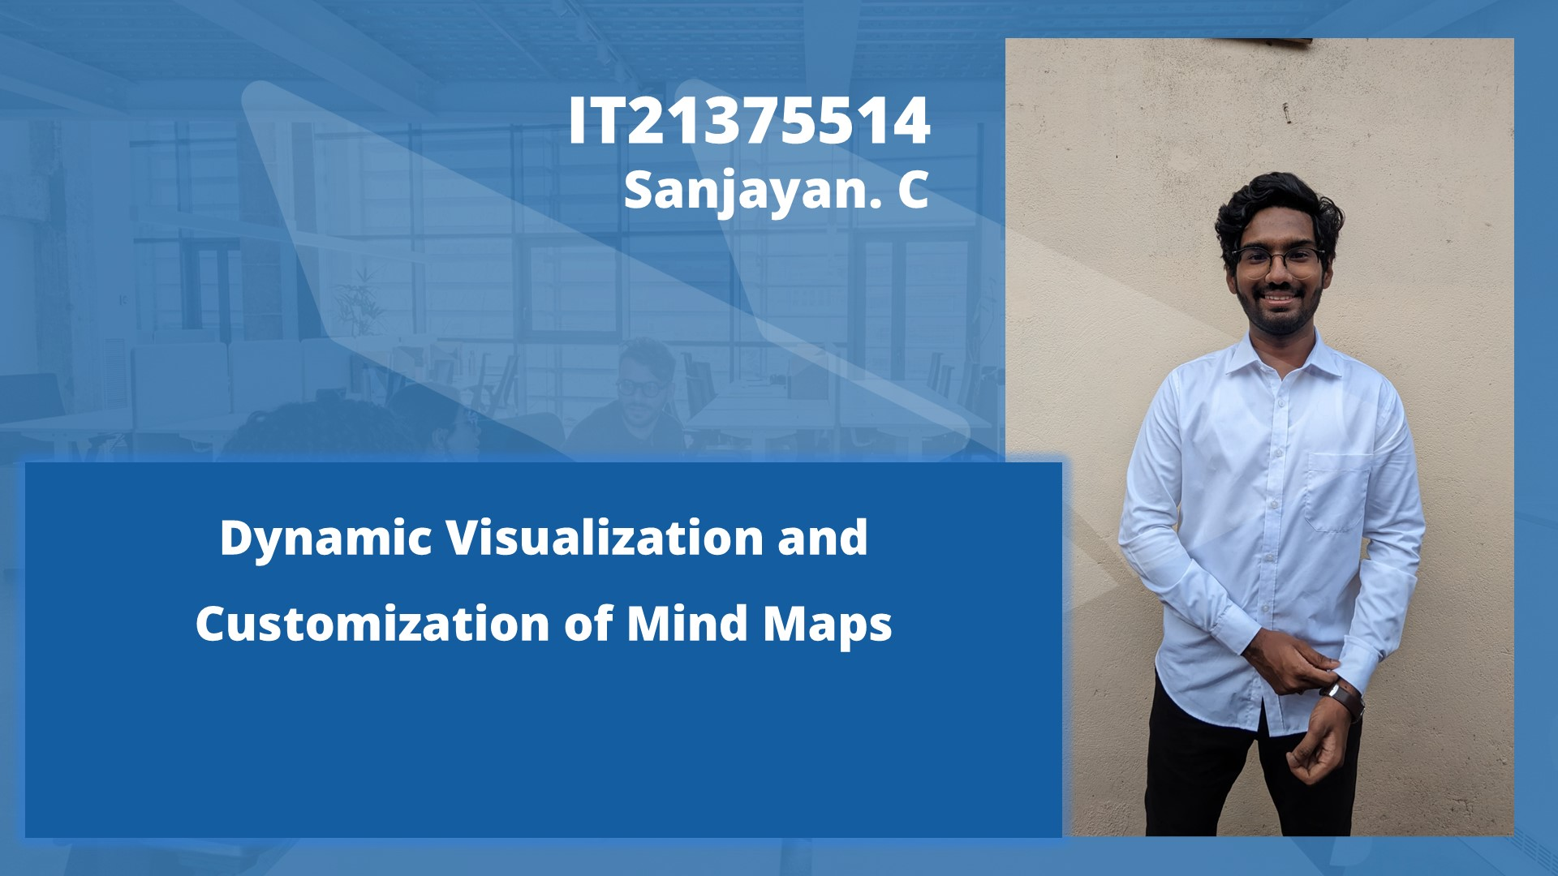
IT21375514 | Sanjayan. C | 24-25J-146
04/12/2024

Slide 34
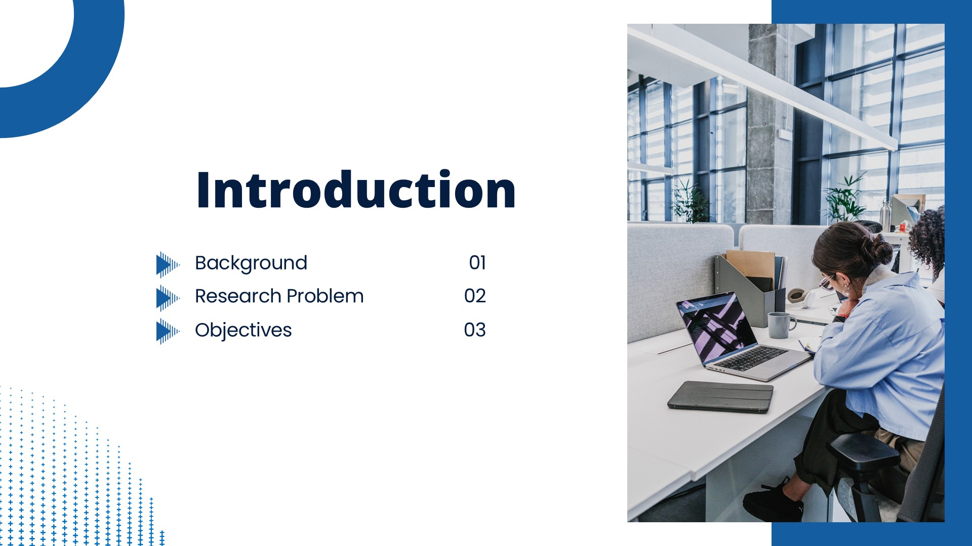
IT21375514 | Sanjayan. C | 24-25J-146
04/12/2024

Slide 35
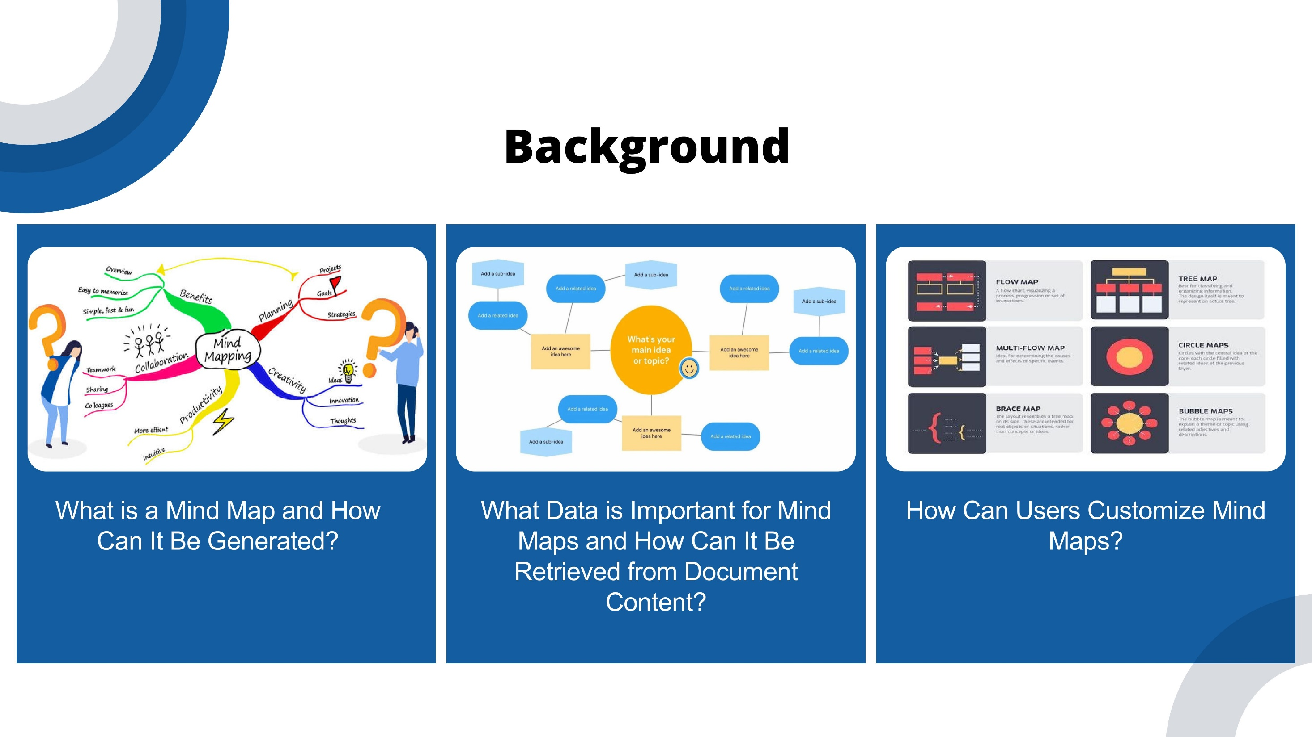
IT21375514 | Sanjayan. C | 24-25J-146
04/12/2024

Slide 36
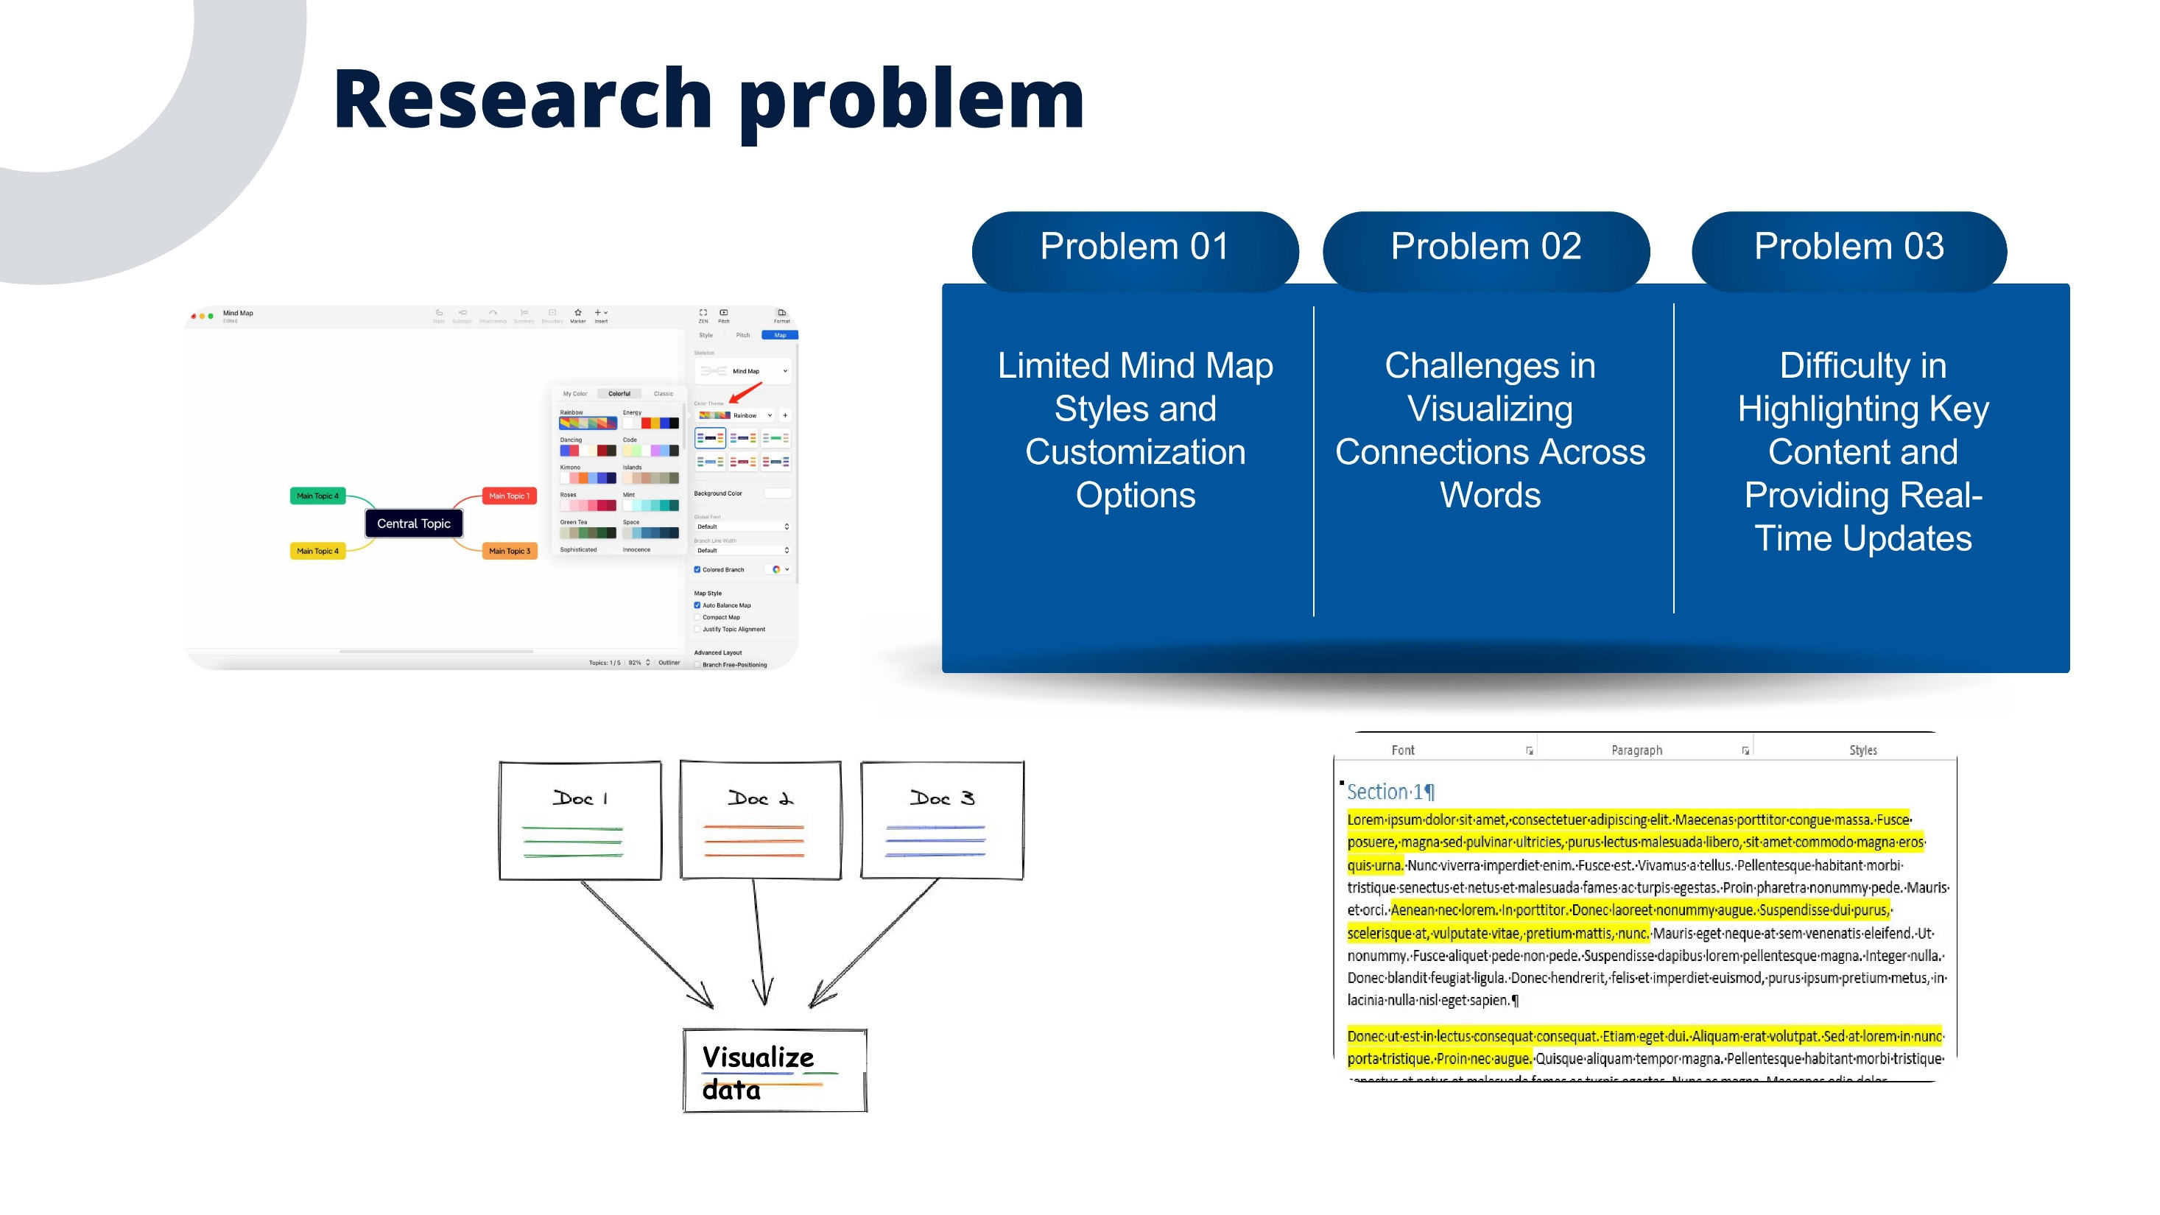
IT21375514 | Sanjayan. C | 24-25J-146
04/12/2024

Slide 37
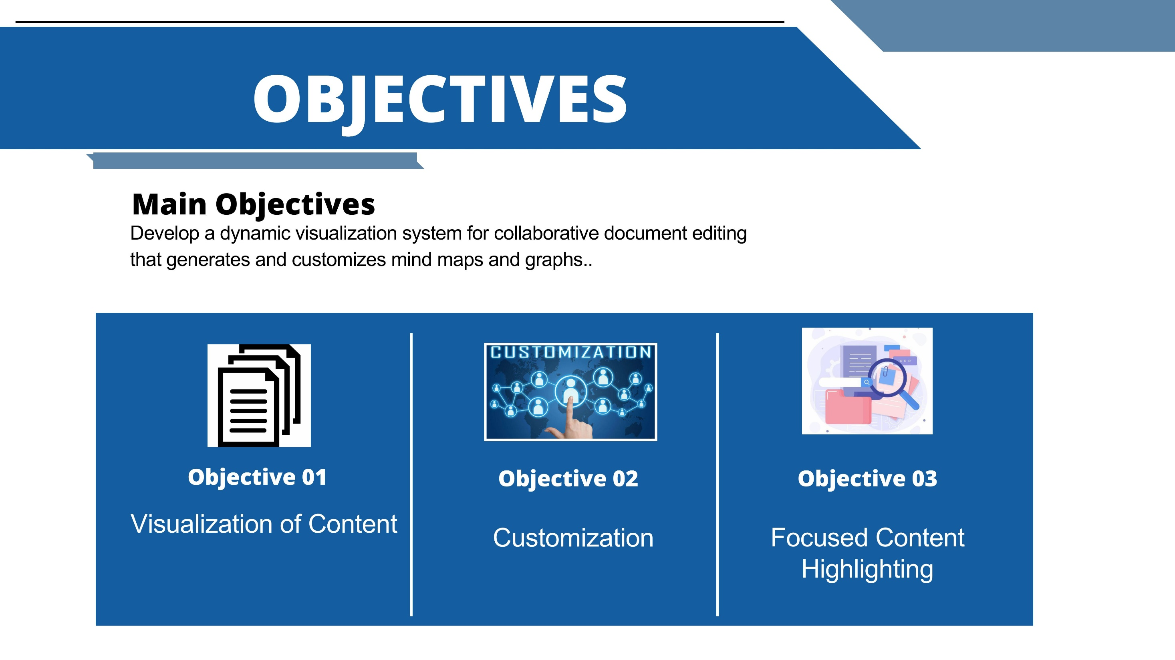
IT21375514 | Sanjayan. C | 24-25J-146
04/12/2024

Slide 38
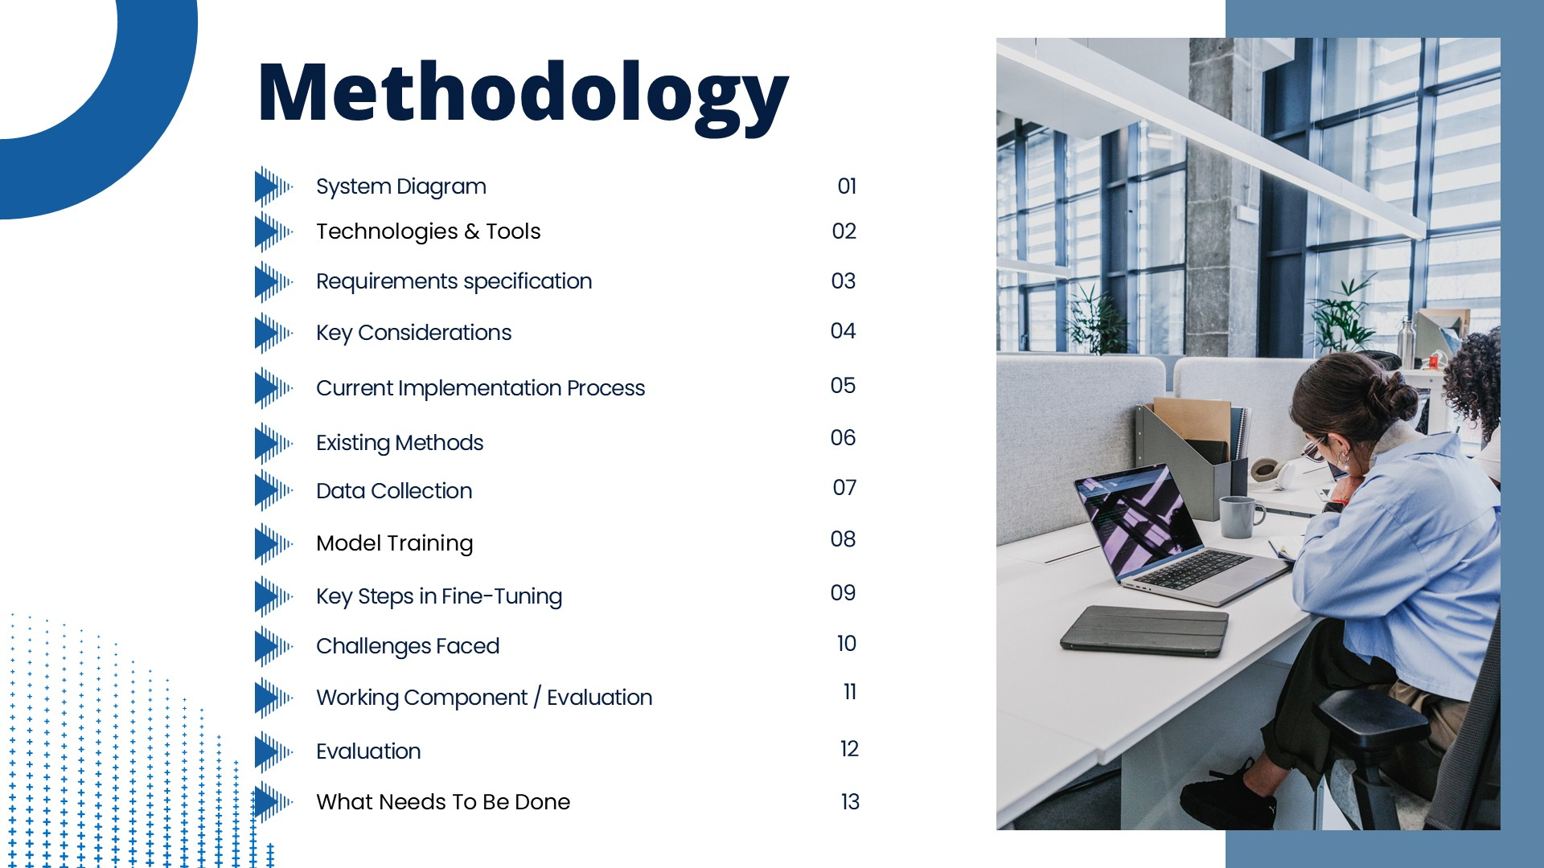
IT21375514 | Sanjayan. C | 24-25J-146
04/12/2024

Slide 39
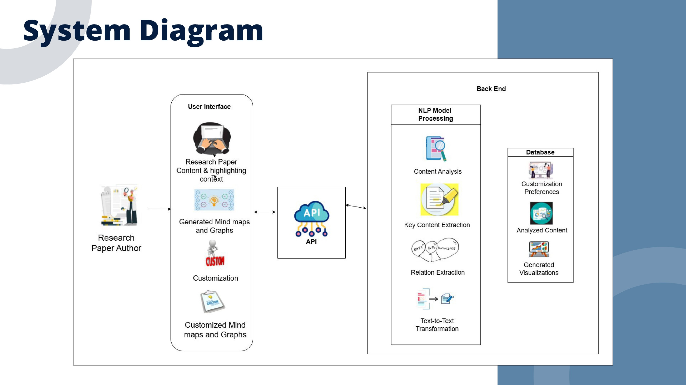
IT21375514 | Sanjayan. C | 24-25J-146
04/12/2024

Slide 40
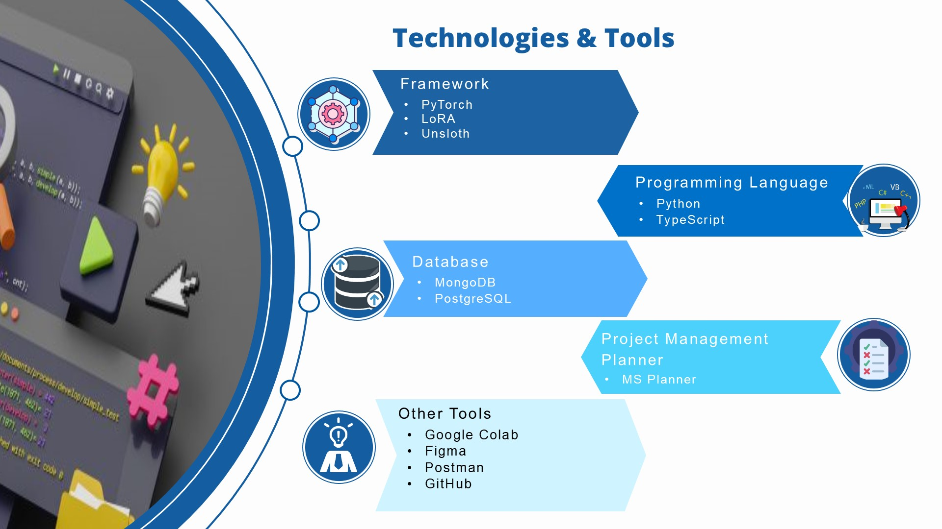
IT21375514 | Sanjayan. C | 24-25J-146
04/12/2024

Slide 41
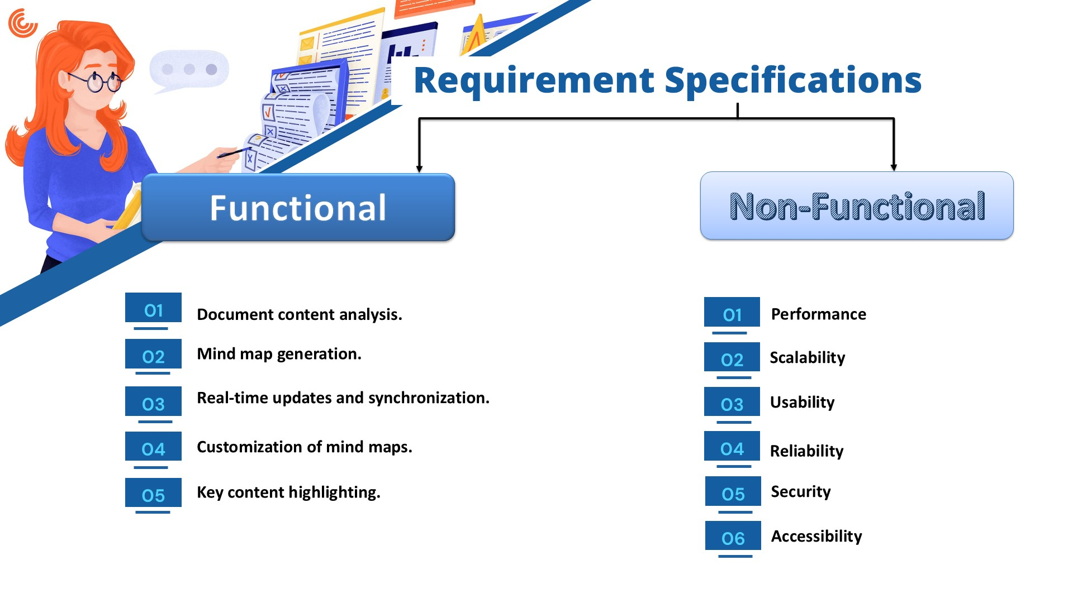
IT21375514 | Sanjayan. C | 24-25J-146
04/12/2024

Slide 42
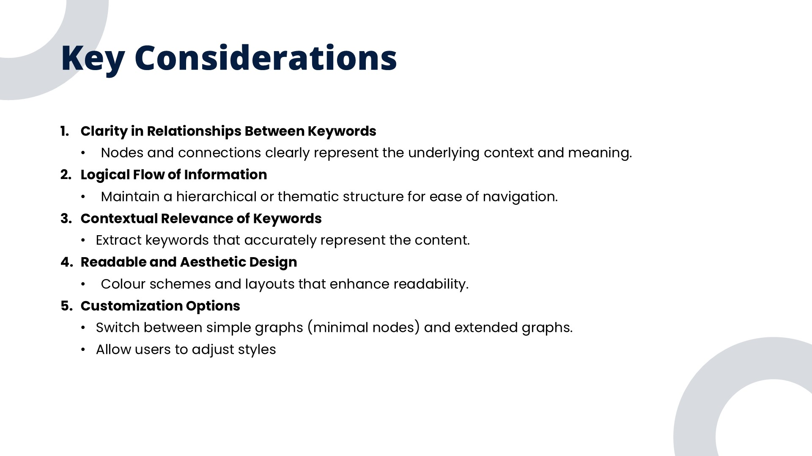
IT21375514 | Sanjayan. C | 24-25J-146
04/12/2024

Slide 43
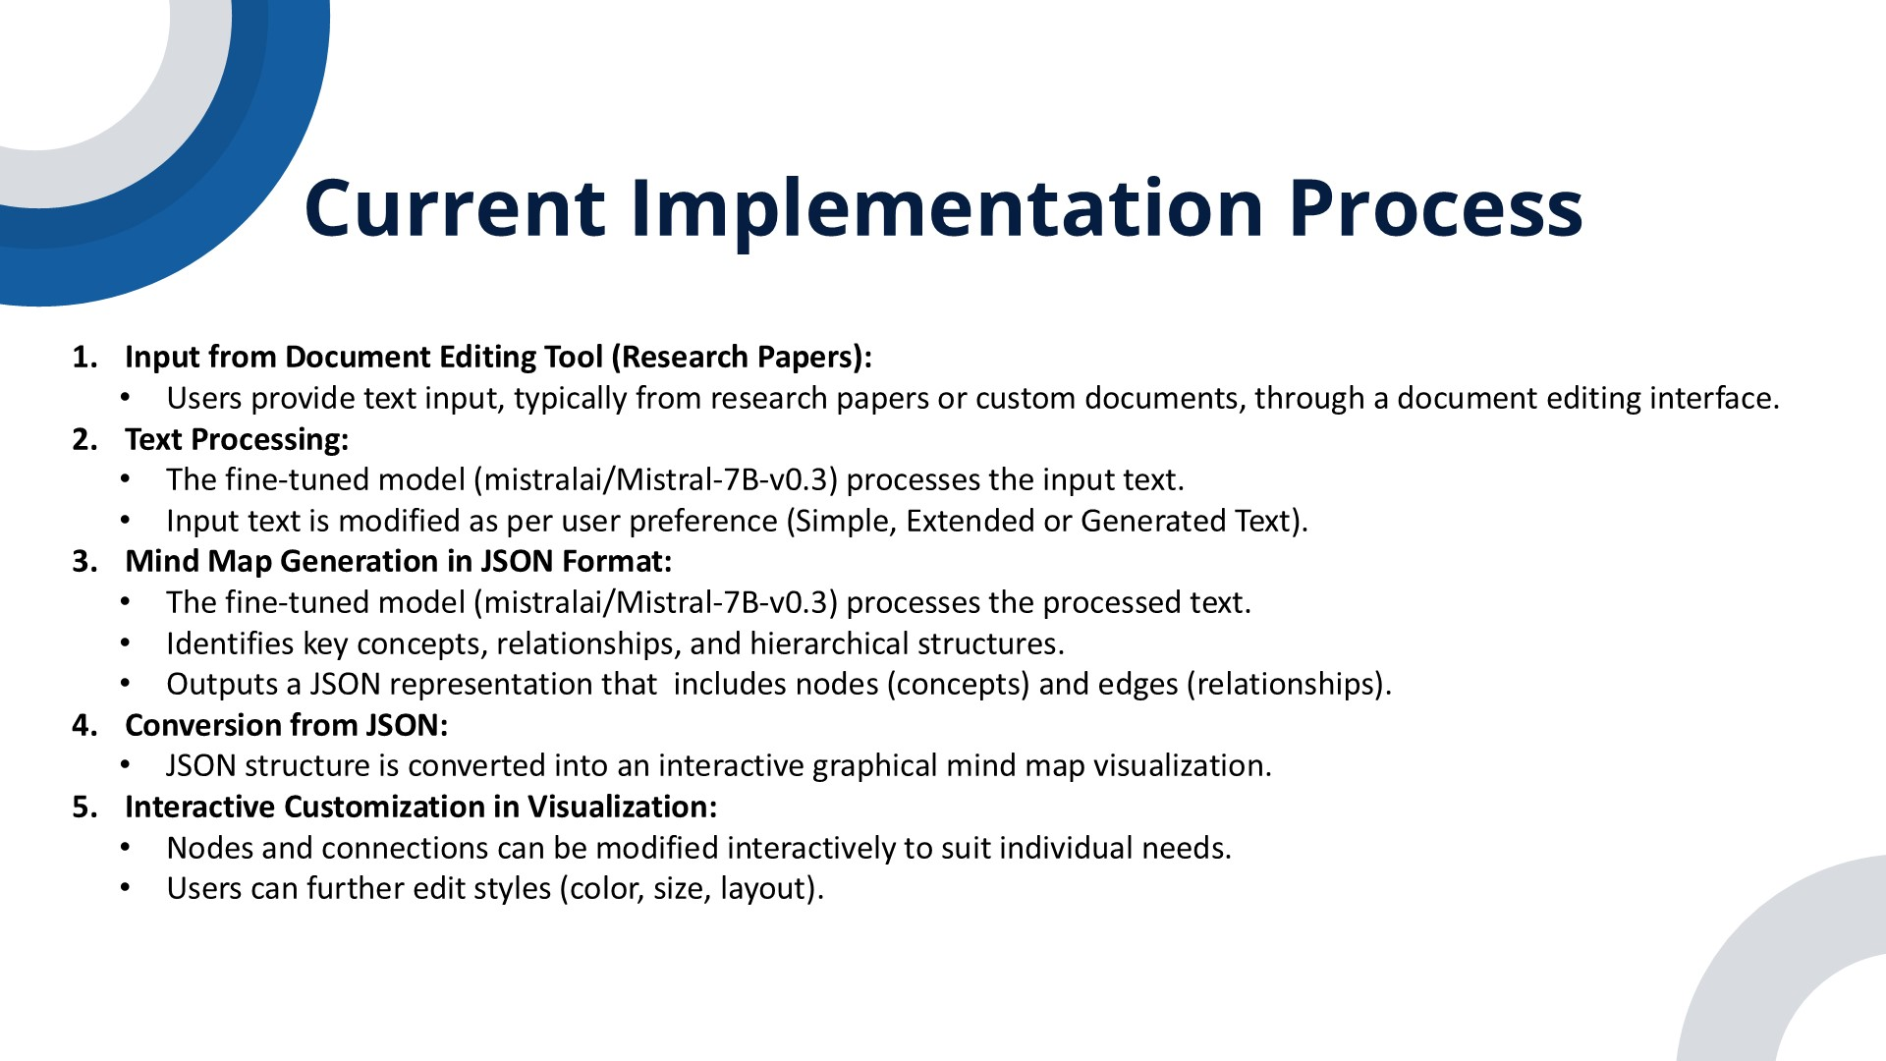
IT21375514 | Sanjayan. C | 24-25J-146
04/12/2024

Slide 44
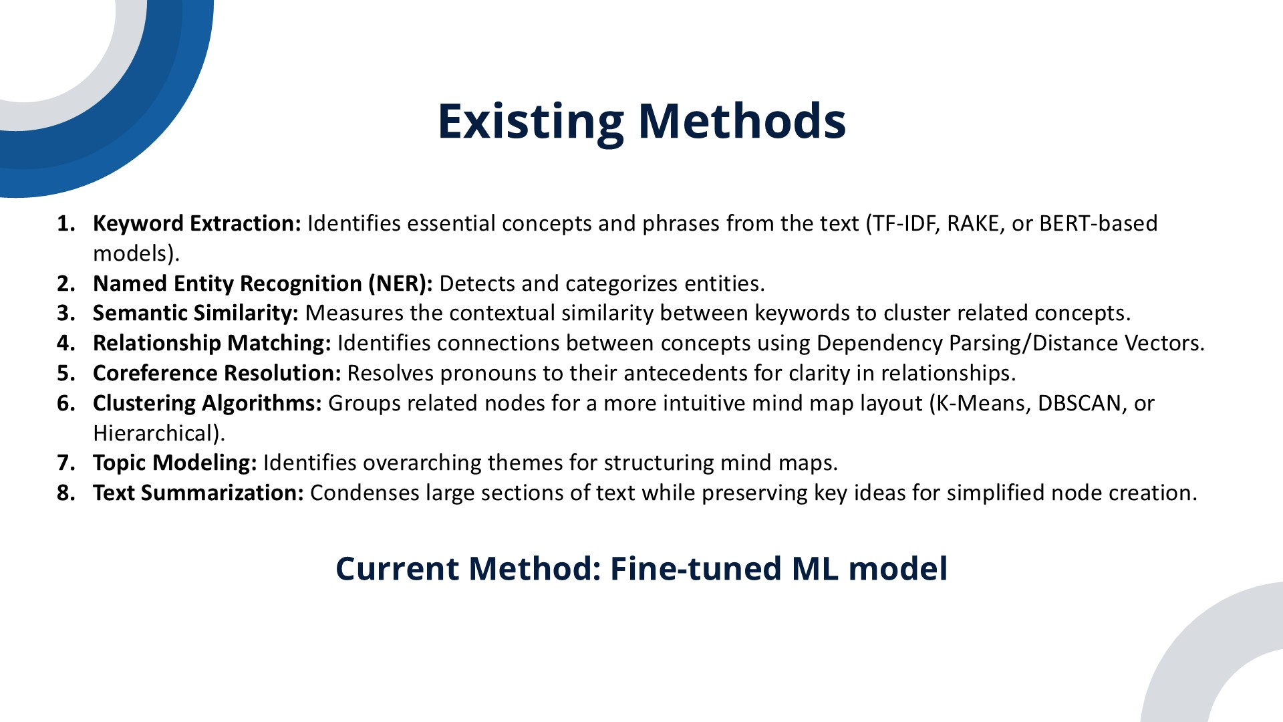
IT21375514 | Sanjayan. C | 24-25J-146
04/12/2024

Slide 45
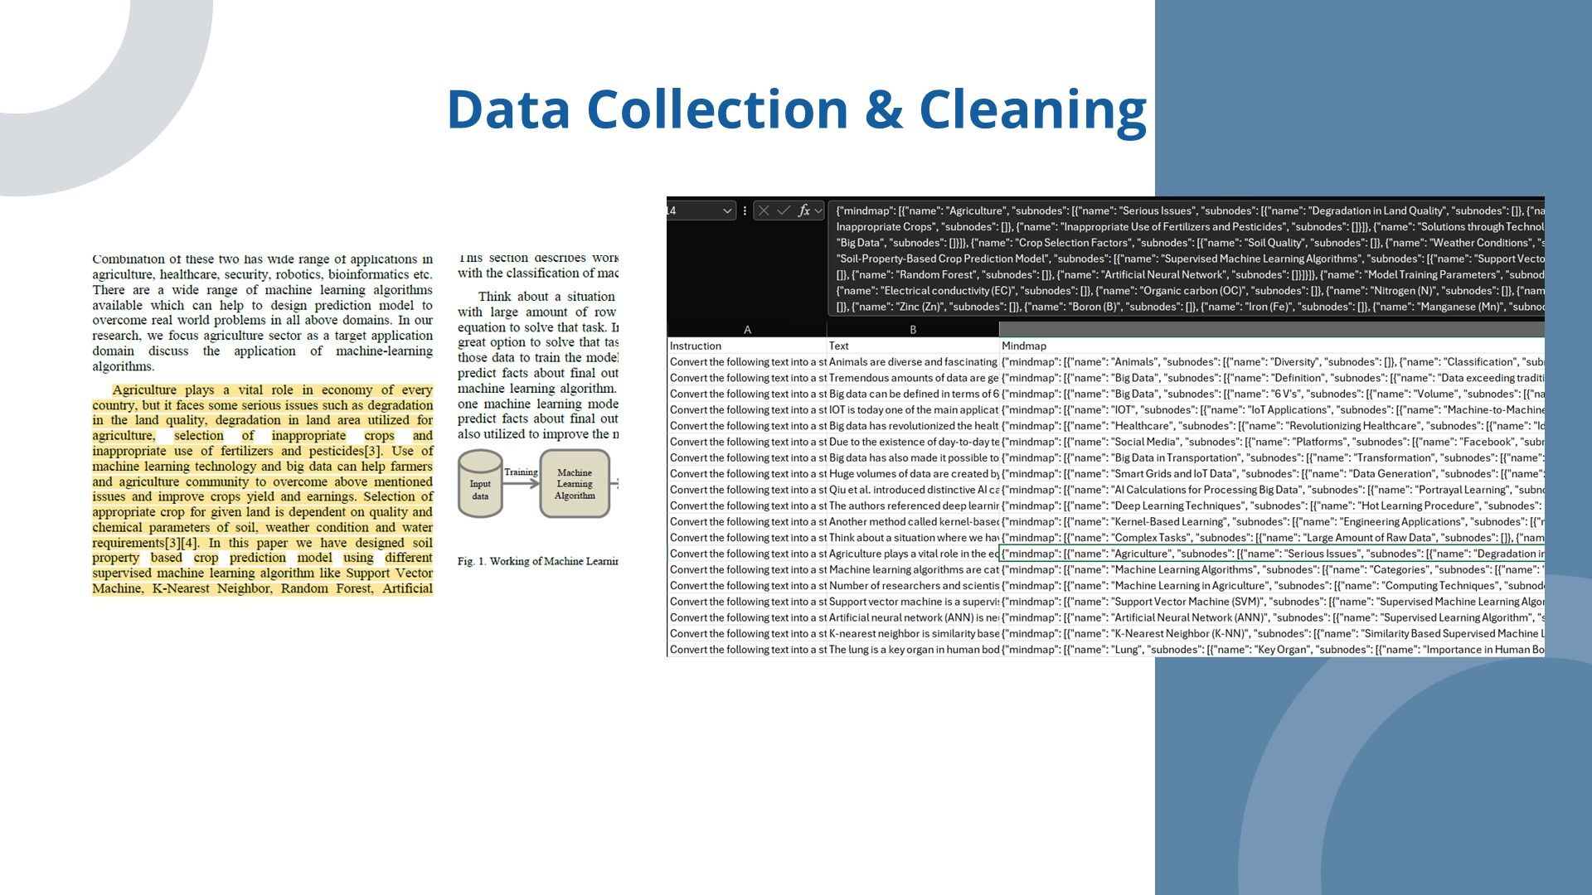
IT21375514 | Sanjayan. C | 24-25J-146
04/12/2024

Slide 46
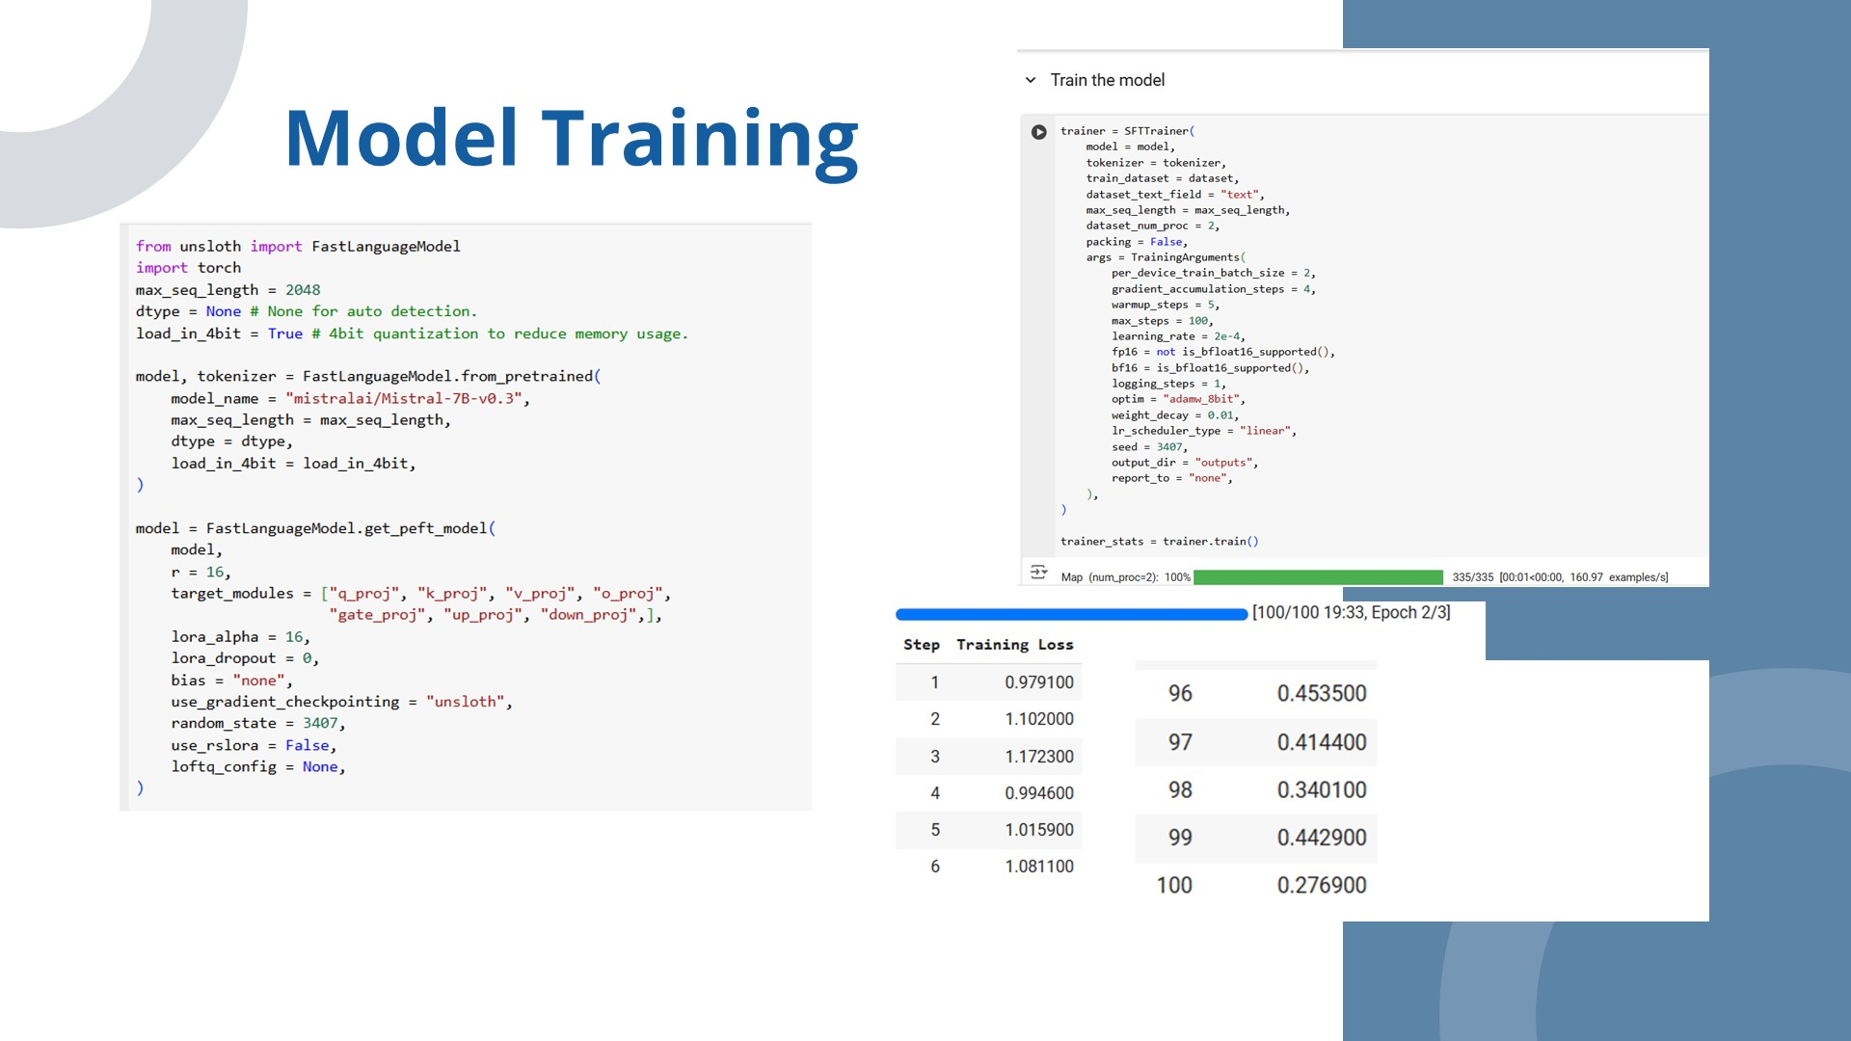
IT21375514 | Sanjayan. C | 24-25J-146
04/12/2024

Slide 47
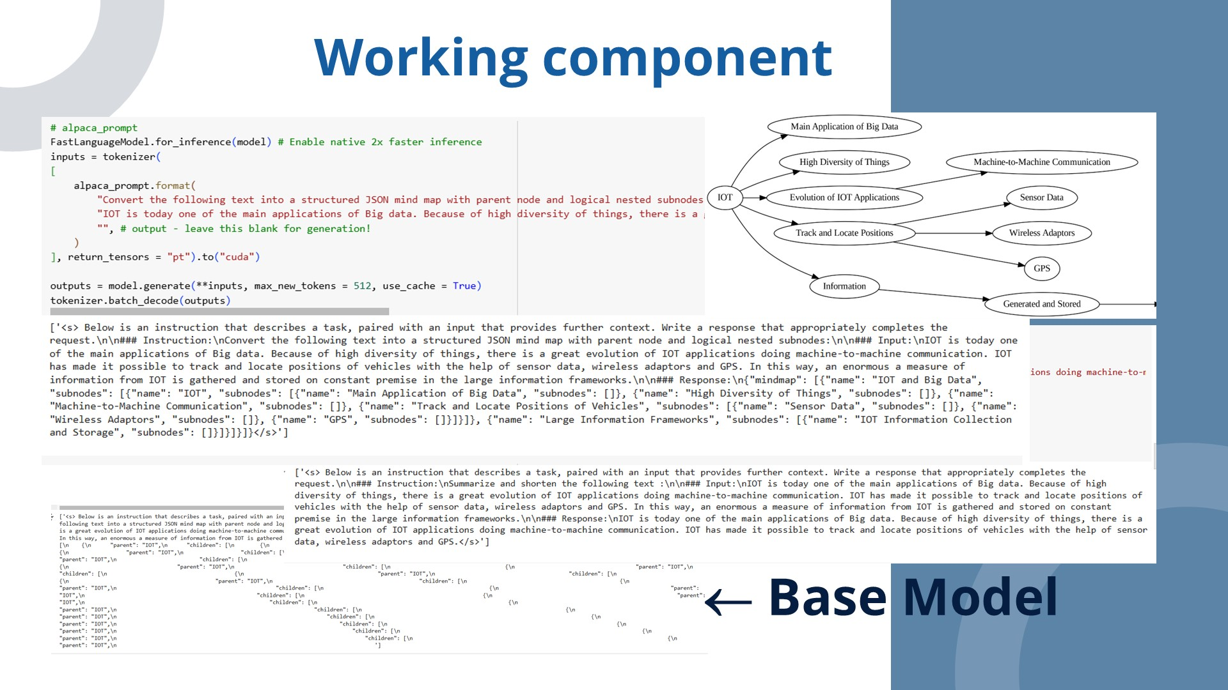
IT21375514 | Sanjayan. C | 24-25J-146
04/12/2024

Slide 48
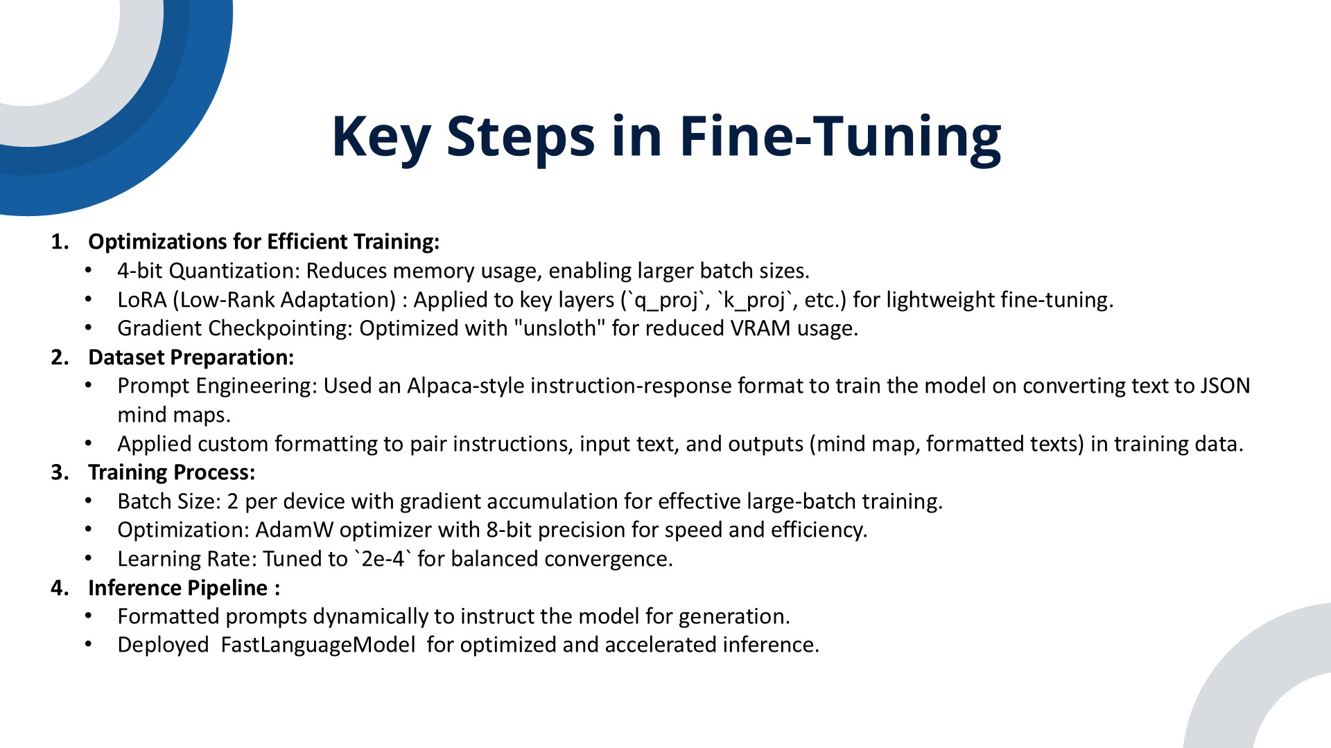
IT21375514 | Sanjayan. C | 24-25J-146
04/12/2024

Slide 49
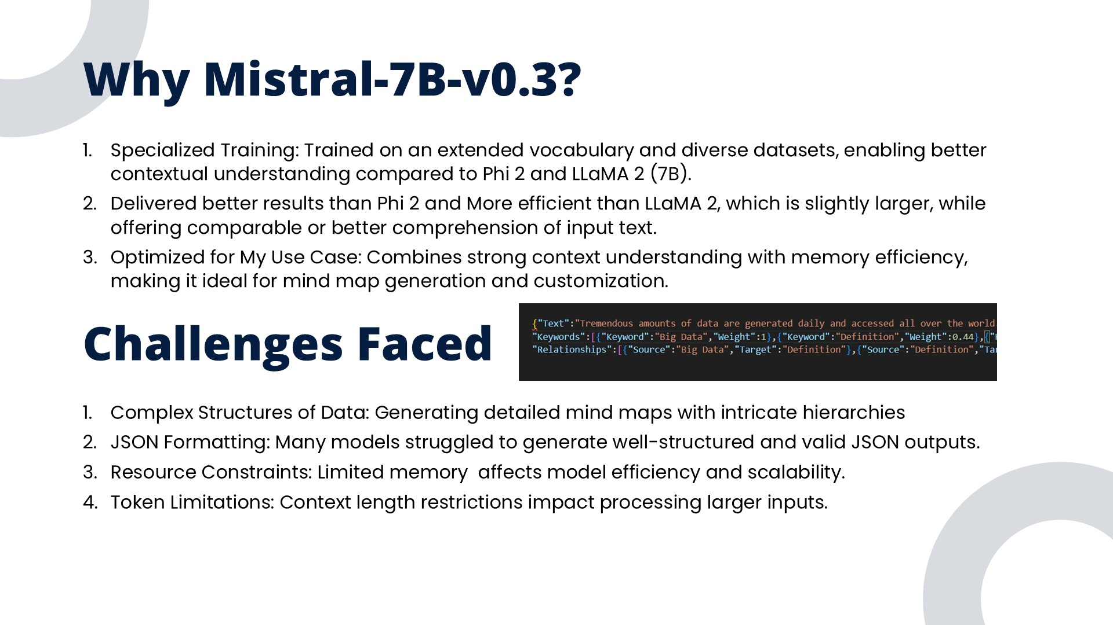
IT21375514 | Sanjayan. C | 24-25J-146
04/12/2024

Slide 50
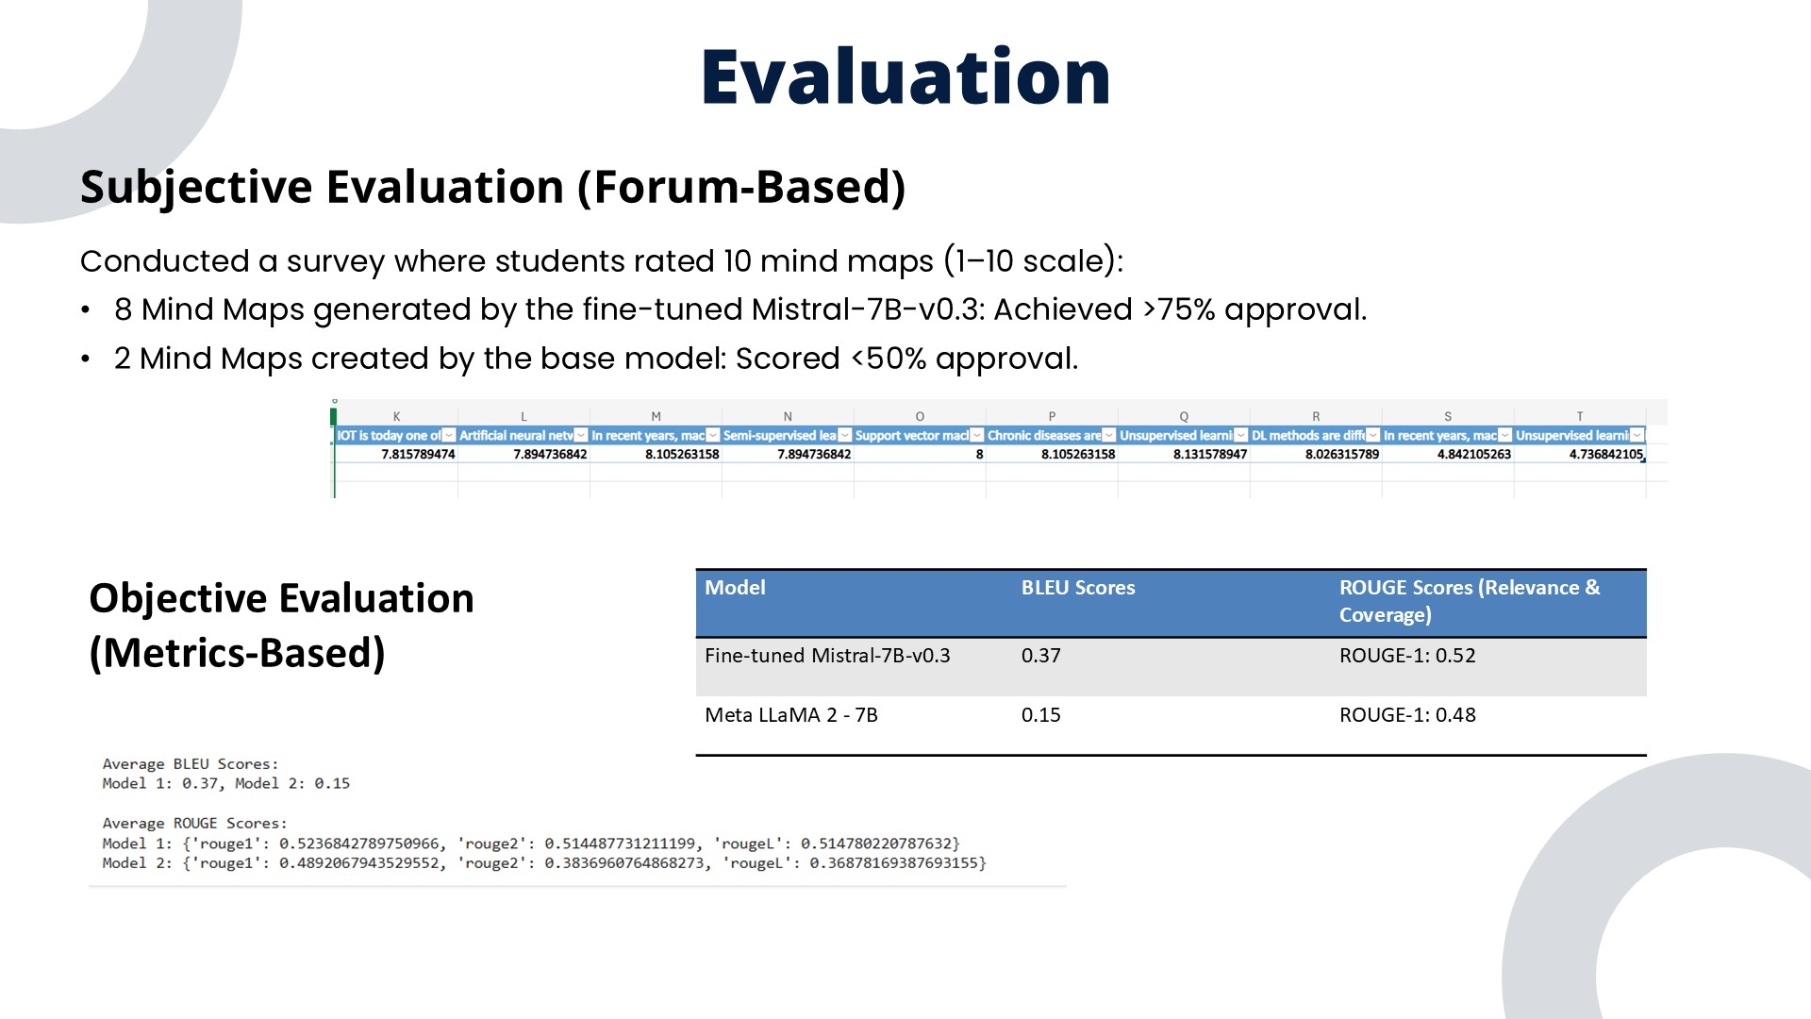
IT21375514 | Sanjayan. C | 24-25J-146
04/12/2024

Slide 51
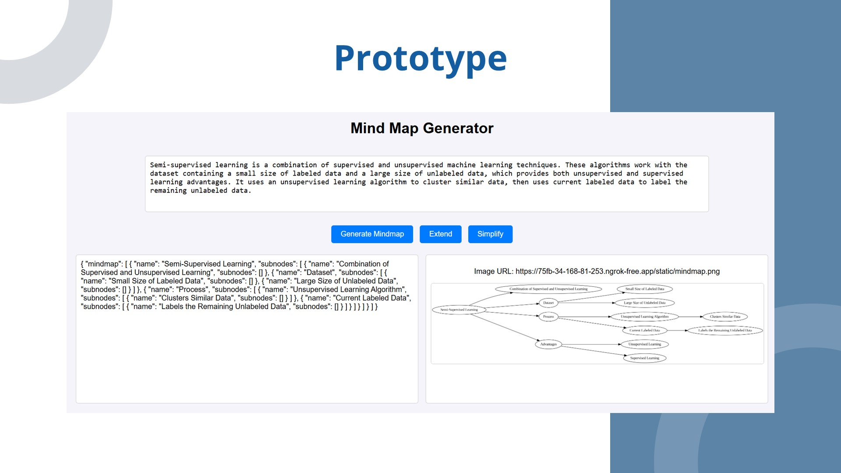
IT21375514 | Sanjayan. C | 24-25J-146
04/12/2024

Slide 52

IT21375514 | Sanjayan. C | 24-25J-146
04/12/2024

Slide 53

IT21375514 | Sanjayan. C | 24-25J-146
04/12/2024

Slide 54

IT21375682 | Shandeep. J | 24-25J-146
04/12/2024

Slide 55
IT21375682 | Shandeep. J | 24-25J-146
04/12/2024

Slide 56

IT21375682 | Shandeep. J | 24-25J-146
04/12/2024

Slide 57

IT21375682 | Shandeep. J | 24-25J-146
04/12/2024

Slide 58

IT21375682 | Shandeep. J | 24-25J-146
04/12/2024

Slide 59

IT21375682 | Shandeep. J | 24-25J-146
04/12/2024

Slide 60

IT21375682 | Shandeep. J | 24-25J-146
04/12/2024

Slide 61

IT21375682 | Shandeep. J | 24-25J-146
04/12/2024

Slide 62

IT21375682 | Shandeep. J | 24-25J-146
04/12/2024

Slide 63

IT21375682 | Shandeep. J | 24-25J-146
04/12/2024

Slide 64

IT21375682 | Shandeep. J | 24-25J-146
04/12/2024

Slide 65

IT21375682 | Shandeep. J | 24-25J-146
04/12/2024

Slide 66

IT21375682 | Shandeep. J | 24-25J-146
04/12/2024

Slide 67

IT21375682 | Shandeep. J | 24-25J-146
04/12/2024

Slide 68

IT21375682 | Shandeep. J | 24-25J-146
04/12/2024

Slide 69

IT21375682 | Shandeep. J | 24-25J-146
04/12/2024

Slide 70

IT21375682 | Shandeep. J | 24-25J-146
04/12/2024

Slide 71

IT21361036 | Saara M.K.F | 24-25J-146
04/12/2024

Slide 72

IT21361036 | Saara M.K.F | 24-25J-146
04/12/2024

Slide 73

IT21361036 | Saara M.K.F | 24-25J-146
04/12/2024

Slide 74

IT21361036 | Saara M.K.F | 24-25J-146
04/12/2024

Slide 75

IT21361036 | Saara M.K.F | 24-25J-146
04/12/2024

Slide 76

IT21361036 | Saara M.K.F | 24-25J-146
04/12/2024

Slide 77

IT21361036 | Saara M.K.F | 24-25J-146
04/12/2024

Slide 78

IT21361036 | Saara M.K.F | 24-25J-146
04/12/2024

Slide 79

IT21361036 | Saara M.K.F | 24-25J-146
04/12/2024

Slide 80

IT21361036 | Saara M.K.F | 24-25J-146
04/12/2024

Slide 81

IT21361036 | Saara M.K.F | 24-25J-146
04/12/2024

Slide 82

IT21361036 | Saara M.K.F | 24-25J-146
04/12/2024

Slide 83

IT21361036 | Saara M.K.F | 24-25J-146
04/12/2024

Slide 84

IT21361036 | Saara M.K.F | 24-25J-146
04/12/2024

Slide 85

IT21361036 | Saara M.K.F | 24-25J-146
04/12/2024

Slide 86

IT21361036 | Saara M.K.F | 24-25J-146
04/12/2024

Slide 87

IT21361036 | Saara M.K.F | 24-25J-146
04/12/2024

Slide 88

IT21361036 | Saara M.K.F | 24-25J-146
04/12/2024

Slide 89

IT21361036 | Saara M.K.F | 24-25J-146
04/12/2024

Slide 90

IT21361036 | Saara M.K.F | 24-25J-146
04/12/2024

Slide 91

IT21361036 | Saara M.K.F | 24-25J-146
04/12/2024

Slide 92

04/12/2024

